Slide 1
ANALYTICAL CHEMISTRY
LECTURE-1
BY
Dr. ABBAS HASAN FARIS

Slide 2
Analytical Chemistry
ANALYTICAL CHEMISTRY: It is a chemistry branch deals with the study on the identification of material composition and the determination of the amount of each component presented by an expression of concentration directly or indirectly (after separation).
It is divided in to two main parts:

Slide 3
1- QUALITATIVE ANALYSIS:
It is process of many steps that through which material, compounds or elements or elements forming certain material or a mixture of materials can be identified at liquid, gas or solid phases. This process is the first step in analysis.
2-QUANTITATIVE ANALYSIS:
It is a process deals with the determination of elements or other components that form the analyzed material (compound or mixture). It tell us what is the amount of the components of the materials or their Components. Quantitative analysis can not be preceded without processing qualitative analysis.

Slide 4
Analytes: Are the components of a sample that are to be determined.
Matrix: All other constituents in a sample except for the analytes.
Classifying Analytical Techniques:
1- Classical Techniques
2- Instrument Techniques

Slide 5
Classical Techniques
Mass, volume, and charge are the most common signals for classical techniques, and the corresponding techniques are:
1- Volumetric techniques (Titrimetric analysis): The analyte reacts with a measured volume of reagent of known concentration, in a process called titration.
2- Gravimetric techniques: usually involves the selective separation of the analyte by precipitation, followed by the very non-selective measurement of mass (of the precipitate).
3- Coulometeric techniques.

Slide 6
INSTRUMENTAL TECHNIQUES
Determination of materials or their components can be performed using instruments that their measurements of certain properties such as conductivity, turbidity, potentiometry, color, refractive index, absorption at UV or visible region etc…provided these measurements depend on and relate to the concentration of the material or its components directly or indirectly.

Slide 7
INSTRUMENTAL TECHNIQUES
1- Spectroscopic methods:- measuring the interaction between the analyte and electromagnetic radiation (or the production of radiation by an analyte).
2- Electroanalytic methods:- measure an electrical property (i.e., potential, current, resistance, amperes, etc.) chemically related to the amount of analyte.

Slide 8
A - Using of Conductivitimeter to measure the conductivity of sample solution which is changing with variation in the component concentration.
B - Using of potentiometer to measure the potential of an electrode which is in equilibrium with the sample solution.
C - Using of UV-visible spectrometer to measure the absorbance of radiation at a wave length that relate to the component directly or to the compound formed by its reaction with a reagent.

Slide 9
STEPS OF CHEMICAL ANALYSIS:
There are a general steps for any analysis process, a modifications in these steps depend on nature, size, the accuracy required, availability of reagents chemicals equipment's and apparatus
STEP 1: CHOICE OF THE METHOD:
The selected method should be suitable to the nature of the sample, number of samples and accuracy required. Some samples like archaeological or forensic samples need a nondestructive method to keep the samples without destruction.

Slide 10
STEP 2: SAMPLING:
Sampling is a very important criterion. It is the fraction of the material with which he plans to work. It is truly representative the whole of it. If the material is big many samples are selected and collected.
STEP 3: PREPARING OF LABORATORY SAMPLE:
The field sample is treated to prepare the laboratory sample required for the analysis.
1. Producing a homogenized sample by crashing, grinding and mixing.
2. Decreasing the size of the material sample granules.
3. Turning the sample into a phase and formula can be attacked by reagent.
4. Care should be taken to avoid the interferences or any other factors affecting the estimation such as contamination.

Slide 11
STEP 4: MEASURE THE QUANTITY OF THE SAMPLE:
If the sample is solid certain weight of the dried homogenized sample is taken using calibrated balance. If it is liquid certain volume is taken.
STEP 5: DISSOLUTION OF THE MEASURED SAMPLE:
A suitable solvent is selected to dissolve the sample completely and within short time. The sample should not interfere in the analysis. Water is a magic solvent for almost all the inorganic materials and some of the organic materials. Organic materials require organic solvents like alcohols, carbontetrachloride and chloroform. Fusion is used for melting samples do not dissolve in solvents.

Slide 12
STEP 6: SEPARATION OF THE INTERFERING SUBSTANCES.
To measure the sample freely from interferences by other components certain steps should be taken such as separation or using masking agents.
STEP 7: COMPLETION OF THE ANALYSIS
This step concern with the measurement of the substance or component under consideration precisely using a suitable method by precipitation or color formation, titration etc.

Slide 13
STEP 8: CALCULATIONS AND DATA ANALYSIS:
From the numeric results obtained by measurements the final result is calculated using the weight of the analyzed sample. The final results may e evaluated by statistic analysis.

Slide 14
METHODS OF EXPRESSION OF CONCENTRATION
Concentration:- is a general measurement unit stating the amount of solute present in a known amount of solution.
concentration$=\frac{amount of solute}{amount of solution}$

Slide 15
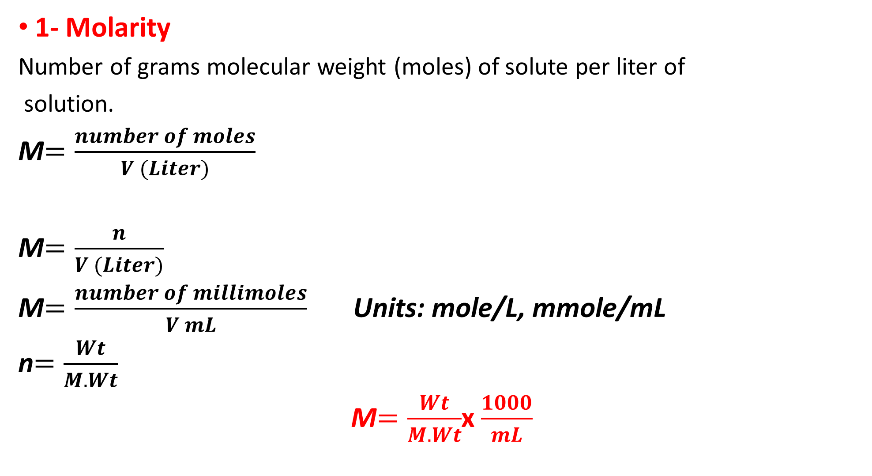
1- Molarity
Number of grams molecular weight (moles) of solute per liter of
solution.
M$=\frac{number of moles}{V (Liter)}$
M$=\frac{n}{V (Liter)}$
M$=\frac{number of millimoles}{V mL}$ Units: mole/L, mmole/mL
n$=\frac{Wt}{M. Wt}$
M$=\frac{Wt}{M. Wt}$x $\frac{1000}{mL}$

Slide 16
Ex: How many grams of 0.125 M AgNO3 used to prepare 500ml of its solution.
( M.Wt= 169.9 g/mole)
M $= \frac{Wt}{M. Wt }×$ $\frac{1000}{VmL}$⇒ 0.125 $= \frac{Wt}{169.9}×$ $\frac{1000}{500}$
$Wt = \frac{\text{M} ×\text{M}\text{. }\text{WT}×\text{VmL}}{1000}$
$Wt = \frac{\text{0}.125 ×\text{169.}\text{9}×\text{500}}{1000}$ $=$ 10.619 g

Slide 17
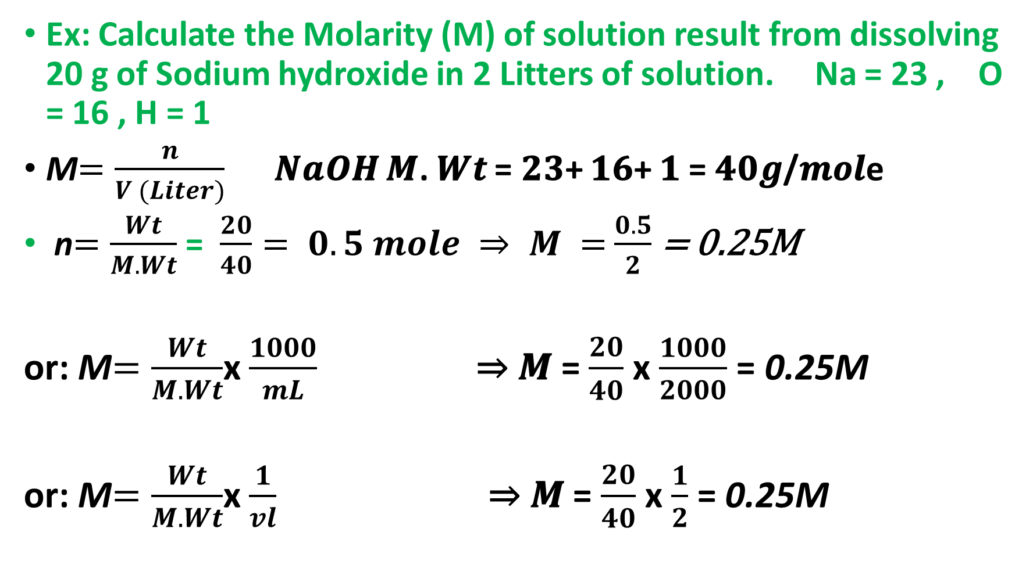
Ex: Calculate the Molarity (M) of solution result from dissolving 20 g of Sodium hydroxide in 2 Litters of solution. Na = 23 , O = 16 , H = 1
M$=\frac{n}{V (Liter)}$ 𝑵𝒂𝑶𝑯 𝑴. 𝑾𝒕 = 𝟐𝟑+ 𝟏𝟔+ 𝟏 = 𝟒𝟎𝒈/𝒎𝒐𝒍e
n$=\frac{Wt}{M. Wt}$ = $\frac{20}{40}= 0.5 mole ⇒ M =$ $\frac{0.5}{2}$ = 0.25M
or: M$=\frac{Wt}{M. Wt}$x $\frac{1000}{mL}$ ⇒ 𝑴 = $\frac{20}{40}$ x $\frac{1000}{2000}$ = 0.25M
or: M$=\frac{Wt}{M. Wt}$x $\frac{1}{vl}$ ⇒ 𝑴 = $\frac{20}{40}$ x $\frac{1}{2}$ = 0.25M

Slide 19
2-Normality:
Number of gram equivalent weight of solute per liter of solution
N$=\frac{number of equivelant}{V (Liter)}$ N$=\frac{no. of eq}{V (Liter)}$
$no. of eq =\frac{Wt}{EW}$ Wt: weight of solute, EW: equivalent weight of solute
N$=\frac{no. of meq}{V mL}$ VmL: volume of solution in mL
N$=\frac{Wt}{EW}$ x $\frac{1000}{mL}$ Units: eq/L, eq/mL

