Slide 1
Complexometric Titrations
Complexometry
A volumetric titration involves the formation of a soluble complex between a metal ion (as acceptor) and ligand (as donor) to form coordination bonds.
The metal ion is known as a Central metal atom.
The anion or neutral molecule is known as Ligand (L)
Metal ions are Lewis acid, accepting electron pairs from electro-donating ligands that are Lewis bases.
Ag⁺ + :C–≡N: ⇋ [:N≡C-Ag-C≡N:]–
Lewis acid Lewis base complex ion
(electron pair acceptor) (electron pair donor)

Slide 2
The formation of Complexes
Complexation reactions are important in many areas of science. Complexes play an essential role in many chemical and biochemical processes. For example, the hemoglobin molecule in blood holds the iron atom tightly because the nitrogen of the hemoglobin forms strong complexing bonds, that is nitrogen is a good complexer.
Complexation reactions are widely used in analytical chemistry. One of the first uses of these reactions was for titrating cations.
Complex ions (coordination compounds) are produce from reaction of many metal ions (electrons accepter) with electron pair donors.
The donor species (or called ligands) must have at least one pair of unshared electrons for bond formation.

Slide 3
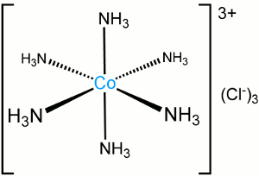
Metals ions, especially transition metals, act as Lewis acids, because they accept electrons from Lewis bases
• When metal cations combine with Lewis bases, the resulting species is called a complex ion or coordination complexes
COMPLEX= LIGAND + METAL ION

Slide 4
A ligand is an ion or molecule that forms a covalent bond with a cation or neutral metal atom by donating a pair of electrons, which are then shared by the two. Ligands can be classified into inorganic ligands such as water, ammonia, and halide ions, and organic ligands such as 8-hydroxyquinoline.
a) anionic ligands : like , SCN⁻ , CN⁻ , OH⁻ ,…….ect.
b) molecular ligands : like , H₂O , NH₃ , RNH₂ , …..ect.
[Ag(CN⁻)₂], [Cu(NH₃)₄]⁺² , [Zn(H₂O)₄]⁺²
Species formed as a result of coordination can be classified as positive
or neutral or negative :
Cu⁺² + 4NH³⁺ → [Cu(NH₃)₄]⁺² ………………….. cationic complex
Cu⁺² + NH₂CH₂COO⁻ → Cu(NH₂CH₂COO)₂ ….. neuteral complex
Cu⁺² + 4Cl⁻ → CuCl₄⁻² ………………………….. anionic complex

Slide 5
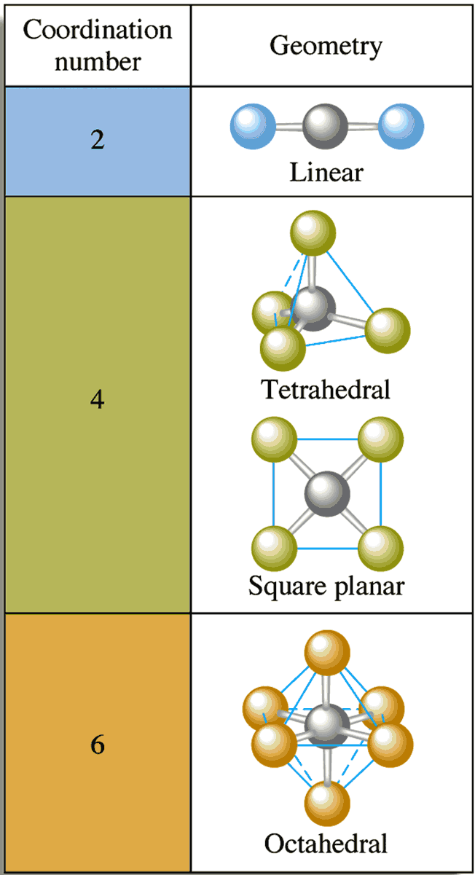
Coordination Number:-
The number of covalent bonds that a cation tends to form with electron donors is called the coordination number.
Common coordination numbers are 2, 4 and 6

Slide 6
Chelates: are produced when a metal ion coordinates with two or more donor groups of a single ligand to form a five or six-member heterocyclic ring and form a cyclic structure.
The key difference between ligands and chelates is that ligands are the chemical species that are donating or sharing their electrons with a central atom through coordination bonds, whereas chelates are compounds containing a central atom bonded with surrounding ligands.

Slide 7
A ligand that has:
single donor group is called unidentate
two donor groups is called bidentate
three donor groups is called tridentate
four donor groups is called tetradentate
five donor groups is called pentadentate
six donor groups is called hexadentate
Tetradentate and hexadentate ligands are more satisfactory as titrants than ligands with a lesser number of donor groups because their reactions with cations are more
A titration based on the formation of a coordination complex is known as a complexometric titration.
• Complexometric titrations are particularly useful for the determination of a mixture of different metal ions in solution.

Slide 8
Chelation
• Chelate : It is a complex formed between the ligand containing two or more donor groups and metal to form ring structure. (heterocyclic rings or chelate rings).
• Chelating agents: organic molecules containing two or more donor groups which combine with metal to form complex having ring structure.
Chelates are usually insoluble in water but soluble in organic solvent.

Slide 15
Composition of EDTA solution as a function of pH :
The most common echelon (or titrant) used in complexation titration is EDTA (ethylenediaminetetraacetic acid).
EDTA is a weak acid dissociate in four steps :
H₄y + H₂O H₃y- + H₃O⁺
H₃y⁻ + H₃O⁺ H₂y⁻² + H₃O⁺
H₂y⁻² + H₃O⁺ Hy⁻³ + H₃O⁺
Hy⁻³ + H₃O⁺ y⁻⁴ + H₃O⁺
These values refer to that the first two protons are lost much more readily than the remaining two.
CT = [H₄y] + [H₃y-] + [H₂y⁻²] + [Hy⁻³] + [y⁻⁴]
It found that EDTA values depend upon the pH of the solution, which is :

Slide 16
a) when pH (3 - 6), H₂y⁻² is predominant.
b) when pH (6 -10), Hy⁻³ is predominant.
c) at pH > 10 , y⁻⁴ is predominant .
EDTA is hexadentate because each nitrogen atom has an unshared pair of electrons in addition to four acidic hydrogens, thus, the molecule has six potential sites for bonding with a metal ion.
the presence of hydrophilic groups such as COOH, SO₃H, NH₂, and OH, when both acidic and basic groups are present, the complex will be soluble over a wide pH range.
When hydrophilic groups are absent, the solubilities of both the chelating agent and the metal chelate will be low, but they will be soluble in organic solvents

