Slide 1
Plotting precipitation titration curves
• Consider the titration of Cl⁻ with a standard solution of AgNO₃.
• Titration curve prepared by plotting pCl (-log[Cl⁻]) against the volume of AgNO₃ in a manner similar to acid-base titration.
• Before titration started – only have Cl⁻.
pCl = - log[Cl⁻]
• Titration proceed – part of Cl⁻ is removed from solution by precipitation as AgCl.
pCl = -log [remaining Cl⁻]
• At equivalence point - we have solution a saturated solution of AgCl. [Cl-] =$\sqrt{KSP}$

Slide 2
• Excess AgNO₃ added – excess Ag⁺. [Cl⁻] is determine from the concentration of Ag⁺ and Ksp.
[Cl⁻] = Ksp/[Ag⁺]
Plots of titration curves are normally sigmoidal curves consisting of pAg (or pAnalyte) versus volume of AgNO₃ solution added.
A useful relationship can be derived by taking the negative logarithm of both sides of a solubility-product expression. Thus, for silver chloride,
𝐾𝑠𝑝 = [ 𝐴𝑔⁺] [𝐶𝑙⁻]
𝑙𝑜𝑔𝐾𝑠𝑝 = −log( [𝐴𝑔⁺] [𝐶𝑙⁻] )
-𝑙𝑜𝑔𝐾𝑠𝑝 = − log [𝐴𝑔 ⁺] + (− 𝑙𝑜𝑔 [𝐶𝑙⁻])
𝑝𝐾𝑠𝑝 = 𝑝𝐴𝑔⁺ + 𝑝𝐶𝑙 ⁻

Slide 3
EX. Derive a titration curve for the titration of 50ml of 0.1M NaCl with 0.1M AgNO₃ , KSP AgCl = 1.82x10⁻¹⁰ ?
Notes :
1) In precipitation titration we are using molar and formal conc. and we are not using normal conc.
2) Precipitation titration methods are used to determine halogen ions.
3) Precipitation titration curves are plotted as :
4) Precipitation titration curve is influenced by the concentrations. of Ag⁺ and Cl⁻
5) Precipitation titration curve is influenced by KSP value (completeness of reaction). when the KSP value is small the titration curve is perfect.

Slide 4
Ansewer of example :
a) before adding AgNO3 :
NaCl → Na⁺ + Cl⁻
0.1 0.1 0.1
pCl = - log [Cl⁻] = - log 0.1 = 1
pAg = zero
b) after adding 10 mL of AgNO₃ :
NaCl + AgNO₃ → AgCl + NaNO₃
(50x0.1) (10x0.1) 0
5 1 0
4 0 1

Slide 5
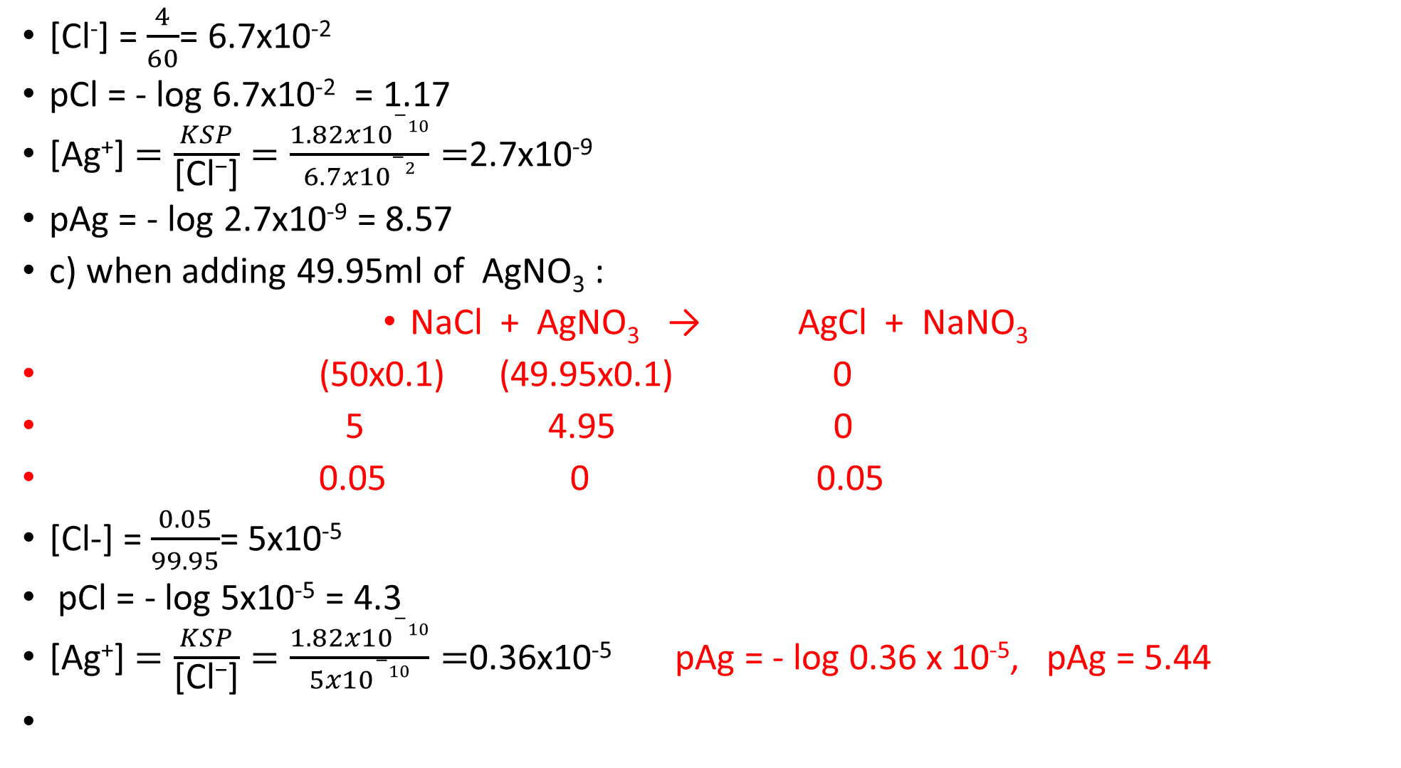
[Cl⁻] = $\frac{4}{60}$= 6.7x10⁻²
pCl = - log 6.7x10⁻² = 1.17
[Ag⁺] $=\frac{KSP}{\text{[}\text{Cl}\text{−}\text{]}}=\frac{1.82x10−10}{6.7x10−2}=$2.7x10⁻⁹
pAg = - log 2.7x10⁻⁹ = 8.57
c) when adding 49.95ml of AgNO₃ :
NaCl + AgNO₃ → AgCl + NaNO₃
(50x0.1) (49.95x0.1) 0
5 4.95 0
0.05 0 0.05
[Cl-] = $\frac{0.05}{99.95}$= 5x10⁻⁵
pCl = - log 5x10⁻⁵ = 4.3
[Ag⁺] $=\frac{KSP}{\text{[}\text{Cl}\text{−}\text{]}}=\frac{1.82x10−10}{5x10−10}=$0.36x10⁻⁵ pAg = - log 0.36 x 10⁻⁵, pAg = 5.44

Slide 6
d) at equivalent point , when adding 50ml of AgNO₃ :
NaCl + AgNO₃ → AgCl + NaNO₃
(50x0.1) (50x0.1) 0
5 5 0
0 0 5
[Ag⁺] = [Cl⁻] = 1.82x10⁻¹⁰
[Cl-]² = 1.82x10⁻¹⁰
[Ag⁺] = [Cl⁻] = 1.35x10⁻⁵
pCl = pAg = 4.87

Slide 7

e) after adding 52.5ml of AgNO3 :
NaCl + AgNO₃ → AgCl + NaNO₃
(50x0.1) (52.5x0.1) 0
5 5.25 0
0 0.25 0.25
[Ag⁺] = $\frac{0.25}{102.5}$= 2.4x10⁻³
[Cl⁻] = $\frac{1.82x10−10}{2.4x10−3}$=
pAg = 2.62
pCl = 7.12

Slide 8
Factors affecting the solubility of precipitates
Solubility is important factor in gravimetric analysis which requires pure material. This means there is a need for washing the precipitate to remove impurities and obtain pure precipitate .
1 - Nature of the precipitate: If the attraction between solvent molecules and solute ions is higher than that between solute ions in the crystal then the salt is soluble.
2 - Nature of solvent: Two properties of the solvent affecting the solubility of the solute, these are polarity and dielectric value . Solvent of more polarity means more attraction between solute ions and solvent molecules. The attraction at crystal surface decreases with higher electric constant of the solvent. Water as with high polarity and dielectric constant value is a good solvent for nearly all inorganicionic salts .Organic solvents such as chloroform, alcohols are good solvents for organic salts (non polar compounds) .

Slide 9
3 - Temperature : Higher temperature means higher solubility ; in water this solubility process in endothermic.
4 - Common ion effect: The ion that forms the precipitate is the common ion if the solvent contain these common ions. The solubility of the salts decreases compared with pure solvents. Other uncommon ions increases the solubility.
5 - pH value :The concentration of hydrogen ion and hydroxide ions affect the acidity of the solution and hence the solubility of sparingly soluble solute.

Slide 10
Ex.1. If the solubility of AgBr= 2x10⁻⁵ g/100ml at 20ºC, calculate Ksp value? (M.Wt=187.8 g/mole)
The solubility should be calculated in unit of mole/liter
Concentration volume
2 x 10⁻⁵ 100 ml
x 1000 ml
X= $\frac{2x10−5 x1000}{100}$= 2 x10⁻⁴ g / L
Concentration mole/L= (solute weight (g)/L) / F. Wt
Or: Concentration mole/L= (solute weight (g)/L) / M.Wt
X= $\frac{2x10−4 }{187.8}$= 1.065x10⁻⁶ mol/ L

Slide 11
This means that 1.065 x 10⁻⁶ mole of AgBr is dissolved in one liter of solution (available as ions). Therefore each liter of the solution contains:
[Ag⁺] = 1.065 x 10⁻⁶ mole/L
[Br⁻] = 1.065 x 10⁻⁶ mole/L 2x10⁻⁵
Or: M = mole/L
M= $\frac{Wt}{M.Wt}$x $\frac{1000}{VmL}$= ⇒ M= $\frac{2X10−5}{187.8}$x $\frac{1000}{100}$
=1.065 x 10⁻⁶ mole/L
Ksp can be calculated as follows:
AgBr Ag⁺ + Br⁻
Ksp = [Ag⁺][Br⁻] = 1.065 X 10⁻⁶ mole/L x 1.065 X 10⁻⁶ mole/L
= 1.134 X 10⁻¹²

