Slide 1
ANALYTICAL CHEMISTRY
LECTURE- 5
BY
Dr. ABBAS HASAN FARIS

Slide 2
Oxidation-Reduction Reactions
An oxidation-reduction reaction is any chemical reaction in which the oxidation number of a molecule, atom, or ion changes by gaining or losing an electron. Redox reactions are common and vital to some of the basic functions of life, including photosynthesis, respiration, combustion, and corrosion or rusting.
Often‏ called‏ “redox” ‏reactions‏
• Electrons are transferred between the reactants
One substance is oxidized, loses electrons
• Reducing agent
Another substance is reduced, and gains electrons
• Oxidizing agent
• Oxidation numbers change during the reaction

Slide 3
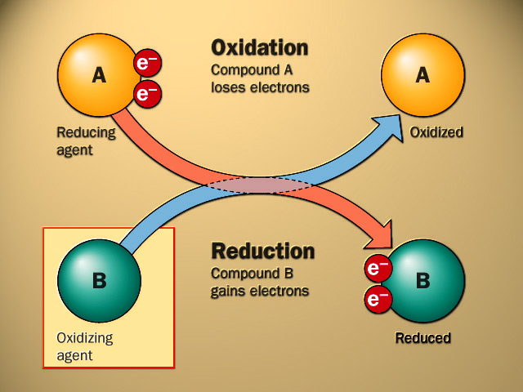
4.4 Oxidation-Reduction
/ Redox Reactions
Electron donor
Electron acceptor

Slide 4
Zn (s) + CuSO₄ (aq) ZnSO₄ (aq) + Cu (s)
Zn Zn²⁺ + 2e⁻
Zn is oxidized
Zn is the reducing agent
Cu²⁺ + 2e⁻ Cu
Cu²⁺ is reduced
Cu²⁺ is the oxidizing agent
Copper wire reacts with silver nitrate to form silver metal.
What is the oxidizing agent in the reaction?
Cu (s) + 2AgNO₃ (aq) Cu(NO₃)₂ (aq) + 2Ag (s)
Cu Cu²⁺ + 2e⁻
Cu is oxidized
Cu is the reducing agent
Ag⁺ + 1e⁻ Ag
Ag⁺ is reduced
Ag⁺ is the oxidizing agent

Slide 6
Example
Zn(s) + CuSO₄(aq) → ZnSO₄(aq) + Cu(s)
Zn(s) + Cu²⁺(aq) → Zn²⁺(aq) + Cu(s)
Zinc is losing 2 electrons and oxidized.
• Reducing agent
• Zn(s) → Zn²⁺(aq) + 2e-
Copper ions are gaining the 2 electrons.
• Oxidizing agent
• Cu²⁺(aq) + 2e- → Cu(s)‏

Slide 7
Rules for assigning oxidation numbers
1. Elements (uncombined) are 0.
Al, N2, He, Zn, Ag, Br2, O2, O3
2. Oxidation numbers must sum to the overall charge of the species.
(SO₄)²⁻ = -2 (O is usually -2 so….)‏
? + 4(-2) = -2
Solve: ? - 8 = -2 ? = + 6 (S)

Slide 8
Balancing redox reactions
– Electrons (charge) must be balanced as well as number and types of atoms – Consider this net ionic reaction:
Al(s) + Ni²⁺(aq) → Al³⁺(aq) + Ni(s)
– The reaction appears balanced as far as the number and type of atoms are concerned, but look closely at the charge on each side.

Slide 9
Al(s) + Ni²⁺(aq) → Al³⁺(aq) + Ni(s)
– Divide reaction into two half-reactions
Al(s) → Al³⁺(aq) + 3e-
Ni²⁺(aq) + 2e- → Ni(s)
– Multiply by a common factor to equalize electrons (the number of electrons lost must equal number of electrons gained)‏
2 [Al(s) → Al³⁺(aq) + 3e- ]
3 [Ni²⁺(aq) + 2e- → Ni(s) ]

Slide 10
Cancel electrons and write balanced net ionic reaction
2Al(s) →2Al³⁺(aq) + 6e-
3Ni²⁺(aq) + 6e- → 3Ni(s)
2Al(s) + 3Ni²⁺(aq) →2Al³⁺(aq) + 3Ni(s)‏

