Slide 7
Example:
Calculate the equilibrium constant for the redox reaction at 25 ⁰C ,
Sr(s) + Mg⁺² (aq) ⇄ Mg(s) + Sr⁺²
that occurs in the Galvanic cell.
E^{O} _{Mg+2/Mg} = -2.37 V and E^{O} _{Sr+2/Sr} = -2.89 V
Hint: As per the electrochemical series of the elements, the metals that are placed below in the series are reduced by accepting electrons in the presence of the elements that are placed higher in the electrochemical series. We shall calculate the value of E⁰_{cell} from the potential of cathode and anode given and use the formula given to find the equilibrium constant.
Formula Used: E⁰_{cell} = E⁰_{reduction} - E⁰_{oxidation}

Slide 8
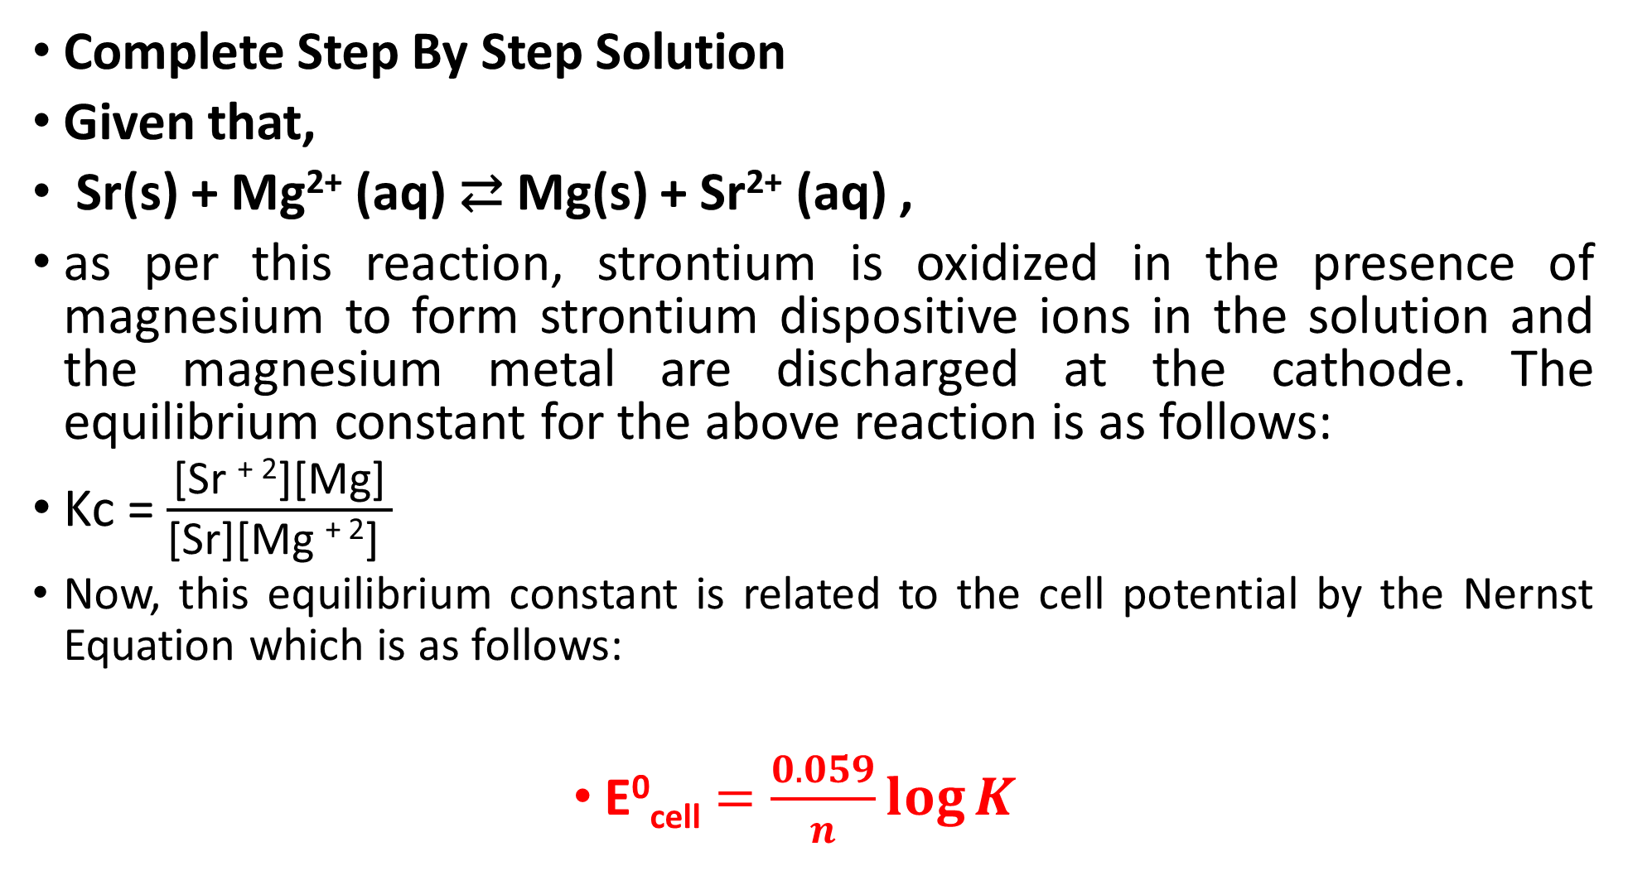
Complete Step By Step Solution
Given that,
Sr(s) + Mg²⁺ (aq) ⇄ Mg(s) + Sr²⁺ (aq) ,
as per this reaction, strontium is oxidized in the presence of magnesium to form strontium dispositive ions in the solution and the magnesium metal are discharged at the cathode. The equilibrium constant for the above reaction is as follows:
Kc = $\frac{\text{[}\text{Sr} \text{+ }\text{2}\text{][}\text{Mg}\text{]}}{\text{[}\text{Sr}\text{][}\text{Mg} \text{+ }\text{2}\text{]} }$
Now, this equilibrium constant is related to the cell potential by the Nernst Equation which is as follows:
E⁰_{cell} $=\frac{0.059}{n}\log{K }$

Slide 9
where, E⁰_{cell} is the cell potential and n is the number of electrons transferred in the process. Since strontium gives up two electrons in the process to get oxidized hence n = 2.
E⁰_{cell} = E⁰_{reduction}−E⁰_{oxidation}
As strontium is getting oxidized and magnesium is getting reduced, so the E⁰_{cell} is,
E⁰cell = E⁰_{reduction}−E⁰_{oxidation}
E⁰_{cell} = −2.37−(−2.89)= 0.52 V
Now, ΔG⁰= −RT lnK_{eq}
Or, −ΔnFE⁰= −RTlnK_{eq}

Slide 10

Therefore, lnK_{eq} $=\frac{\text{−}\text{nF}\text{Δ}\text{E}\text{0}}{RT}=$ $\frac{2×96500×0.52}{8.314×298}$= 40.507
Therefore, lnK_{eq}=40.507 ,
Or K_{eq}=3.908×10¹⁷

Slide 11
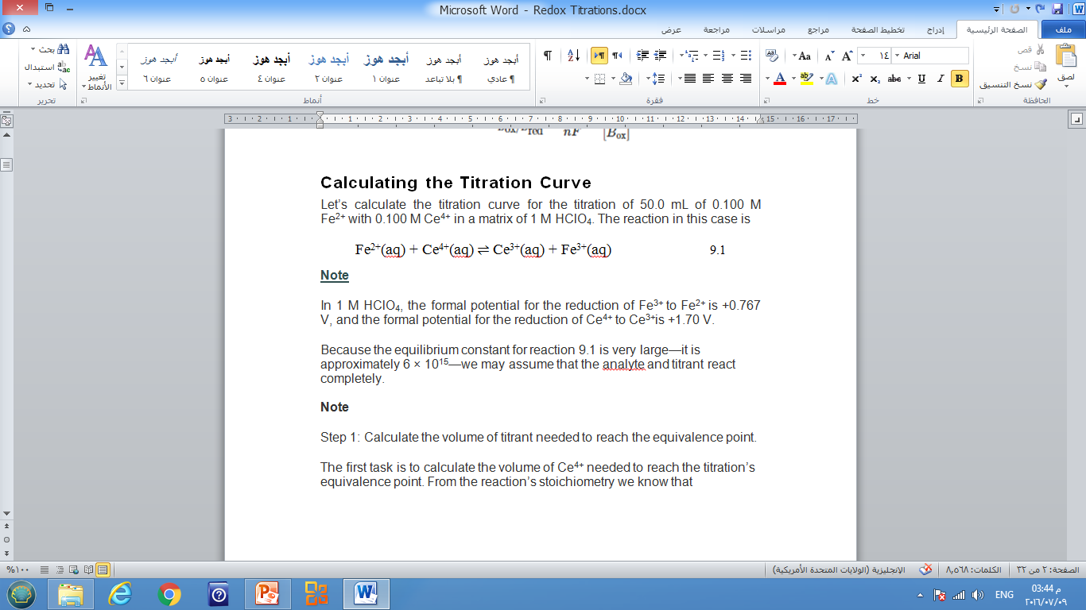

Slide 12
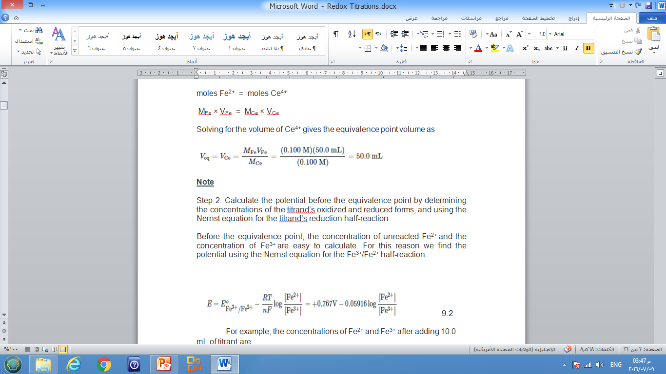

Slide 15
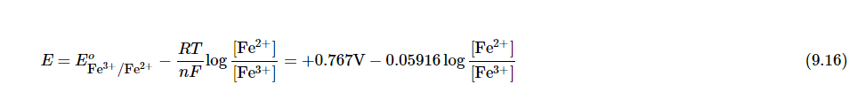
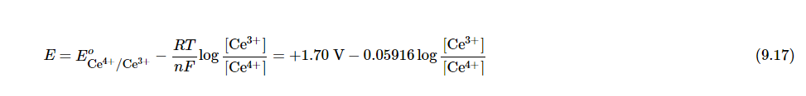

Slide 16
