Slide 1
Concept of the Instrumental Chemical Analysis
Instrumental analysis is a field of analytical chemistry that investigates analytes using scientific instruments.
Classification of Instrumental Analytical Methods:-
1- Qualitative instrumental analysis is that measured property indicates presence of analyte in matrix
2- Quantitative instrumental analysis is that magnitude of measured property is
proportional to concentration of analyte in matrix
Species of interest: All constituents including analyte and Matrix-analyte (concomitants)
Often need pretreatment - chemical extraction, distillation, separation, precipitation

Slide 2
Classical:
Qualitative - identification by color, indicators, boiling points, odors
Quantitative - mass or volume (e.g. gravimetric, volumetric)
Instrumental:
Qualitative - chromatography, electrophoresis and identification by measuring physical property (e.g. spectroscopy, electrode potential)
Quantitative - measuring property and determining relationship to concentration (e.g. spectrophotometry, mass spectrometry) Often, same instrumental method used for qualitative and quantitative analysis.
Instrumental techniques
1- Spectroscopic methods - measuring the interaction between the analyte and electromagnetic radiation (or the production of radiation by an analyte).
2- Electroanalytic methods - measure an electrical property (i.e., potential, current, resistance, amperes, etc.) chemically related to the amount of analyte.

Slide 3
Features of instrumental analysis methods compared to classical
1- More sensitive: they can detect very small amounts of a substance in a small amount of sample that can be up to the ppm
2- More selective and quality
3- great speed and accuracy (they reliably identify elements and compounds)
4- Most of the methods are non-destructive, that is used in cases that do not require destroying the sample

Slide 5
Spectroscopy
Spectroscopy is a branch of science which studies the interaction of electromagnetic radiation with matter where the interaction of radiation with chemical species is measured to obtain characteristics quality and quantity of the species.
Spectroscopic techniques can be divided in to two
Atomic spectroscopy (atomic absorption and atomic emission spectroscopy)
Molecular spectroscopy (Uv-Vis, IR, NMR, MS)
Electromagnetic radiation is a form of energy that is transmitted through space at enormous velocities. Electromagnetic radiation, or light, is described by the properties of both waves and particles nature.
A “particle” of light is called a photon.

Slide 6
We can use different terms to describe light:
• Color
• Wavelength
•Frequency
Light is composed of electromagnetic waves that travel through some medium.
The properties of the medium determine how light travels through it.
In a vacuum, light waves travel at a speed of 3.00 x 10⁸ m/s OR 186,000 miles/s.
The speed of light in a vacuum is a constant that is tremendously important in nature and science—it is given the symbol, c

Slide 10
An electromagnetic wave is characterized by several fundamental properties, including its frequency, velocity, amplitude, phase angle, polarization, and direction of propagation.
Because light behaves like a wave, we can describe it in one of two ways—by its wavelength or by its frequency.
Wavelength, ̄λ”: the linear distance between successive maxima or minima of a wave. Mostly measured in nm = 10⁻⁹ m
The units of wavelength are the micrometer (1 μm = 10⁻⁶ m), usually called
micron. The unit widely used in spectroscopy is the angstrom (1A = 10⁻¹⁰m).
Frequncȳ: ($v)$ the umber of oscillations of the field that occurs per second.
Frequency ($v)$ : how many times the wave goes up and down in a period of time. n has units of inverse time (1/s = Hz [hertz]).

Slide 11
Electromagnetic Radiation
Speed of light can be expressed as $C=vλ$
where ̄λ” is the wavelength;
$v$ is the frequency, and ̄c̅ the speed of light in a medium.
c = speed of light (3.00 x 10⁸ m/s)
$λ$ = wavelength (m)
$v$ = frequency (s⁻¹)
The type of light (ultraviolet, visible, infrared, x-ray, etc.) is defined by either its frequency or wavelength:
The higher the frequency, the higher the energy of radiation a photon of high frequency (short wavelength) has higher energy content than one of lower frequency (longer wavelength).

Slide 14
wavenumber, ̄ṽ” another unit used to describe the wave properties of
electromagnetic radiation which is the reciprocal of wavelength ̄ṽ= 1 ⁄$λ$
Particle Nature of light. When matter absorbs electromagnetic radiation it undergoes a change in energy. The interaction between matter and electromagnetic radiation is easiest to understand if we assume that radiation consists of a beam of energetic particles called photons. When a photon is absorbed by a sample it is destroyed and its energy acquired by the sample. The energy of a photon, in joules, is related to its frequency, wavelength, and wavenumber.
The energy of light can be determined either from its wavelength or frequency:
$E=\frac{hc}{λ}$ OR $E=$ $hv$
Planck’s constant: h = 6.626 x 10⁻³⁴ J s

Slide 15
The electromagnetic spectrum is composed of a large range of wavelengths and frequencies (energies). It varies from the highly energetic gamma rays to the very low energy radio-waves. The entire range of radiation is commonly referred to as the electromagnetic spectrum.

Slide 16
Example . The energy difference between the 3p and the 3s orbitals in a sodium atom is 2.107 eV. Calculate the 𝝀 (in nm) that would be absorbed in exciting the 3s electron to the 3p state (l eV = 1.60 X 10^{–19} J).
Solution: $λ=\frac{hc}{E}$ = $\frac{\text{6.626 }\text{x} 10\text{-}34 \text{J}\text{.}\text{s} \text{x} 3\text{x}108 m/s}{\text{2.107 }\text{eV} \text{x} \text{1.60 }\text{X} \text{10}\text{–}\text{19} \text{J}\text{/}\text{ev}}$ = 590 nm
electron volt, unit of energy commonly used in atomic and nuclear physics, equal to the energy gained by an electron (a charged particle carrying unit electronic charge) when the electrical potential at the electron increases by one volt. The electron volt equals 1.602 × 10⁻¹⁹ joule.

Slide 17
Example: Violet light from a mercury lamp has a wavelength of 436 nm:
Calculate energy of light
$$E=\frac{hc}{λ}$$
= $\frac{(6.626 x 10−34 J s)(3.00 x 108 m s−9)}{436 x 10−9 m}$ = 4.56 x 10⁻¹⁹ J

Slide 18
Atoms and molecules absorb and emit light in the ultraviolet (UV), visible (vis), infrared (IR), and microwave (μwave) regions of the electromagnetic spectrum.
Absorption or emission of light in the UV and vis regions involves movement of electrons in the atom or molecule.
One reason UV light is so damaging is that the light has enough energy to break chemical bonds—biological and chemical systems
•E ($λ$ = 300 nm) = 399 kJ mol
•Average bond energy = 380 kJ mol⁻¹

Slide 19
Electromagnetic radiation and its interactions with matter
The interactions of radiation and matter are the subject of spectroscopic studies. The most interesting types of interactions in spectroscopy are absorption and emission of radiation by molecular or atomic species of interest which involve transitions between different energy levels of the chemical species.
Electromagnetic radiation can interact with matter in a number of ways.
If the interaction results in the transfer of energy from a beam of radiant energy to the matter, it is called "absorption" The reverse process in which a portion of the internal energy of matter converted into radiant energy is called "emission"..

Slide 20
Absorption: When radiation passes through a transparent layer of a solid, liquid, or gas, certain frequencies may be selectively removed by the process of absorption. Here, electromagnetic energy is transferred to the atoms or molecules constituting the sample; as a result, these particles are promoted from a lower energy state to higher-energy states, or excited states. Note that at room temperature, most substances are in their lowest energy or ground state.
In emission process, species in an excited state can emit photons of characteristic energies by returning to lower energy states or ground states. Part of the radiation which passes into matter, instead of being absorbed, may be scattered or reflected or may be re-emitted at the same wavelength or a different wavelength upon emerging from the sample. Radiation, which is neither absorbed nor scattered, may undergo changes in orientation or polarization as it passes through the sample.

Slide 21
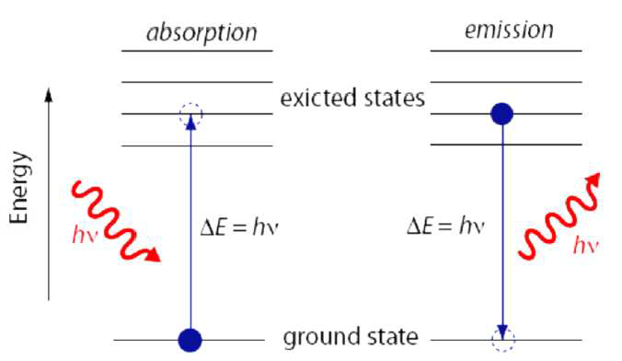
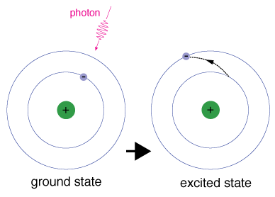
Emission: when an atom or molecule in an excited state returns to a lower energy state, the excess energy often is released as a photon, a process we call emission.
Eg - Ee =ΔE= h $v$ Absorption Ee - Eg = h $v$ emission

Slide 22
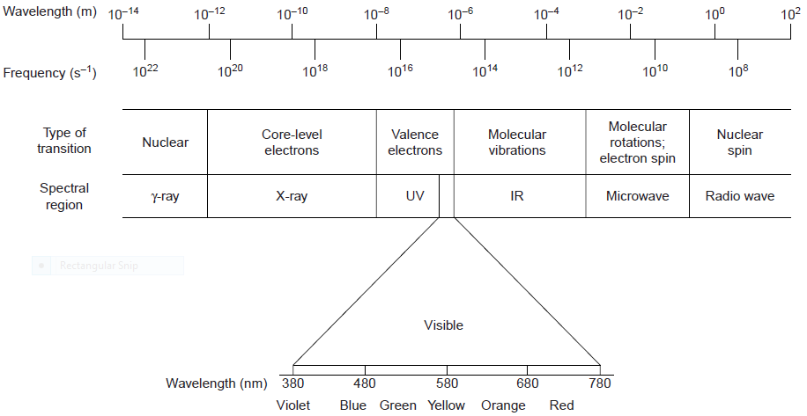
The frequency and wavelength of electromagnetic radiation vary over many orders of magnitude. For convenience, we divide electromagnetic radiation into different regions. The electromagnetic spectrum-based on the type of atomic or molecular transition that gives rise to the absorption or emission of photons. The boundaries between the regions of the electromagnetic spectrum are not rigid, and overlap between spectral regions is possible.

Slide 23
X-ray photons excite inner-shell electrons
ultra-violet and visible-light photons excite outer-shell (valence) electrons
infrared photons are less energetic, and induce bond vibrations
Microwaves are less energetic still, and induce molecular rotation.

Slide 24
Microwave region in electromagnetic spectrum
• Wave number = 1-100 cm⁻¹
• Wavelength = 1 cm – 100 μm
• Frequency = 3 x10¹⁰ – 3 x 10¹² Hz
• Energy = 10 -10³ Joules/mole

Slide 25
Infrared region in electromagnetic spectrum
• Wave number = 14,286-12,800 cm-1
• Wavelength = 700– 1000 nm
• Frequency = 3 × 10¹³ Hz
• Energy = 1.7 eV – 1.24 meV (1.07x10⁻²³ )
1 J = 6.242 X 10¹⁸ ev

Slide 26
visibil region in electromagnetic spectrum
• Wave number = 14,286-12,800 cm⁻¹
• Wavelength = 400– 700 nm
• Frequency = 430 THz – 750 THz
• Energy = 3.3 eV – 1.7 eV

Slide 27
Ultraviolte region in electromagnetic spectrum
• Wave number = 25,000 – 50,000 cm-1
• Wavelength = 100– 400 nm
• Frequency = 750 THz – 30 PHz
• Energy = 124 eV – 3.3 eV

