Slide 1
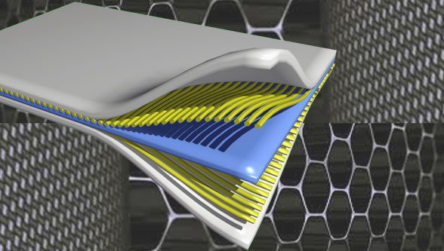
Composite Materials
Dr. Abbas Hasan Faris
Lecture 1

Slide 2
CHE 3322 Composite Materials
Instructor: Dr. Abbas Hsan Faris
Office:
Email: abbashasan@uoanbar.edu.iq
Course Credits: 2
Chem. & Petrochemical Dept. Building .2nd floor. Room No. 3

Slide 3
Course Content:
Introduction Definition classification behaviors of unidirectional composites
Analysis of lamina; constitutive classical laminate theory, thermal stresses,
Classification of reinforcement, Type of fibers, Factors effect of fibers, Mechanical properties of composites, Manufacturing technology, Nano Technology
Micromechanics
Factors influencing strength and stiffness failure modes,
Performance under adverse environment
•Prediction of strength, stiffness

Slide 4
Reference Books/Material:
Composite Materials, Science and Engineering by Krishan K. Chawla
Composite Materials and Applications by Daniel Gay, Suong V. Hoa, Stephen W. Tsai
Any other book on composite materials
Research papers

Slide 5
Grading Policy:
First Exam: 25%
Second Exam: 25%
Assignments: 10% (Individual + Group)
• Absolute 30% for passing. Relative grading after that.
• Assignments should be submitted on the due date, Late submission and copying will be heavily penalized!
• Attendance will be monitored regularly.

Slide 6
Introduction
Composite materials
It is an obvious fact technological development depends on advances in the ﬁeld of materials. One does not have to be an expert to realize that the most advanced turbine or aircraft design is of no use if adequate materials to bear the service loads and conditions are not available. Whatever the ﬁeld may be, the ﬁnal limitation on advancement depends on materials. Composite materials in this regard represent nothing but a giant step in the ever-constant work of improving materials.

Slide 7
The idea of composite materials is not a new or recent one. Nature is full of examples wherein the concept of composite materials is used. The coconut palm leaf, for example, is essentially used as a concept of ﬁber reinforcement. Wood has represented a composite : cellulose ﬁbers in a lignin matrix. The cellulose ﬁbers have high tensile strength but are very ﬂexible (low stiffness), while the lignin matrix joins the ﬁbers and provides the stiffness. Bone is yet another example of a natural composite that supports of various members of the body. It consists of short and soft collagen ﬁbers embedded in a mineral matrix called apatite.

Slide 8
Since the early 1960s, there has been an increasing demand for stiffer and stronger materials yet lighter ones in ﬁelds as diverse as aerospace, energy, and civil construction. The demands made on materials to improve overall performance are so great and diverse that no one material can satisfy them. This naturally led to a resurgence of the old concept of combining different materials in an integral-composite material to satisfy the user requirements.

Slide 9
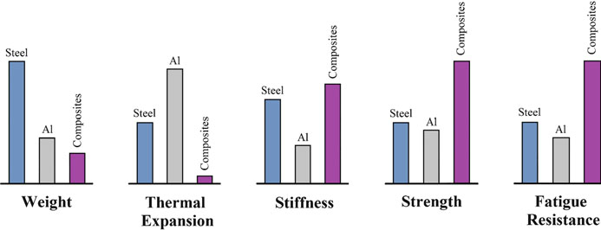
Comparison between conventional monolithic materials and composite materials (1978).

Slide 10
Therefore, we must agree on an operational deﬁnition of composite material for our purposes in this text. We shall call a material that satisﬁes the following conditions a composite material:
1. It is manufactured (i.e., naturally occurring composites, such as wood, are excluded).
2. It consists of two or more phases that are physically and/or chemically distinct, suitably arranged, or distributed with an interface separating them.
3. It should have characteristics that are not depicted by any of the components in isolation.

Slide 11
A composite is a structural material that consists of two or more combined constituents that are combined at a macroscopic level and are not soluble in each other. So that the properties of the composite are different (usually better) from those of the individual constituents.
One constituent is called the reinforcing phase and the one in which it is embedded is called the matrix. The reinforcing phase material may be in the form of fibers, particles, or flakes. The matrix phase materials are generally continuous. Examples of composite systems include concrete reinforced with steel and epoxy reinforced with graphite fibers, etc.

Slide 13
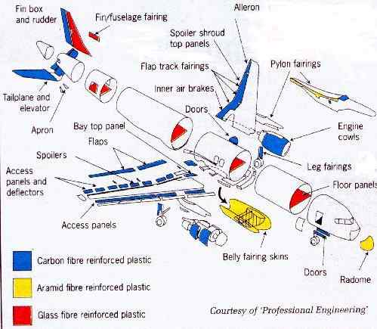

Slide 14
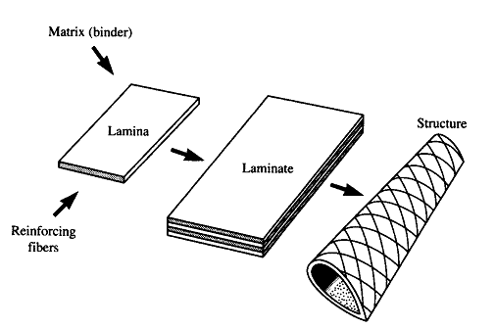
Applications:
– Aerospace industry
– Chemical industries, electrical constructions.
– Sporting Goods Industry
– Automotive Industry
– Home Appliance Industry

Slide 15
The important property that recognizes the composite material on metal is the strength-to-density ratio or strength-to-weight ratio.
Composite is made of
A- Continuous medium “matrix”
B- Discontinuous medium “Reinforcement“ (which is usually harder and stronger one )
Therefore the properties of the composite depend on the properties of the matrix and reinforcement materials, their distribution, and interaction.
Interface: Zone across which matrix and reinforcing phases chemically, physically, and mechanically interact

Slide 16
The simplest composite materials are composed of just two phases.
•The first is termed the matrix, which is continuous and surrounds the other phase which is often called the dispersed phase (Reinforcement phase).
Reinforcement phase
(a) there is a change in the concentration of the dispersed (fiber) material.
(b) the size of the dispersed phase,
(c) the shape,
(d) the distribution,
and (e) the orientation.
•All these will affect the final performance of the composite.

