Slide 1
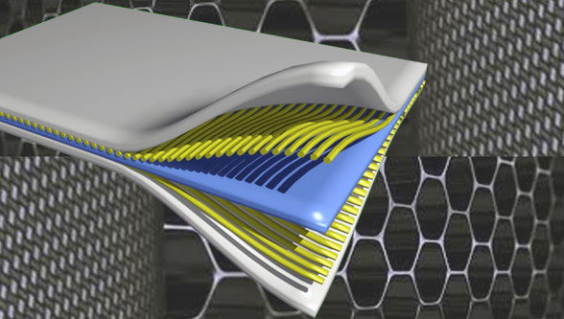
Composite Materials
Dr. Abbas Hasan Faris
Lecture 4

Slide 2
Fiber- reinforcement composite:- A composite in which the dispersed phase is in the form of fiber (i.e., a filament that has a large length-to-diameter ratio). for example, straw-reinforced clay bricks.
Fiber reinforcement of material is very effective because many materials (but not all) are much stronger and stiffer in fiber form than they are in bulk form.
Fibers allow one to obtain the maximum tensile strength and stiffness of a material, but there are disadvantages. Fibers alone cannot support longitudinal compressive loads and their transverse mechanical properties are generally not as good as the corresponding longitudinal (fiber direction) properties. Thus, there is often the need to place fibers in different directions depending upon the particular loading application.

Slide 3
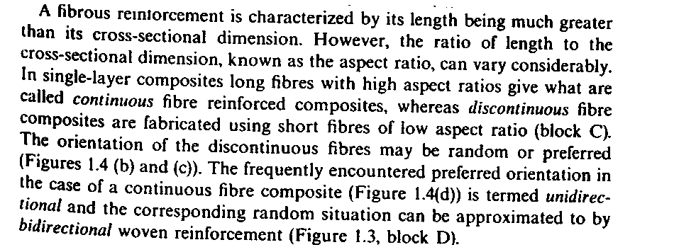

Slide 4
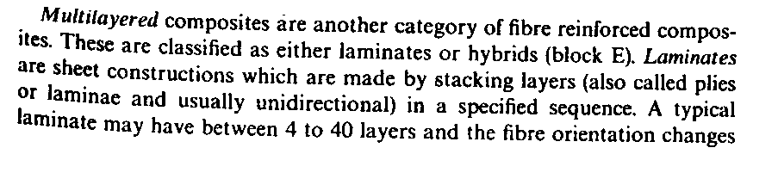
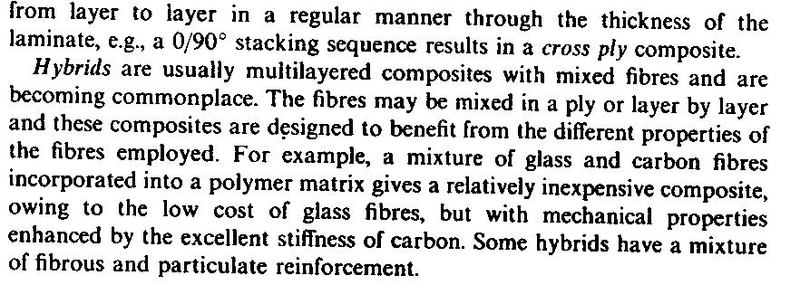

Slide 5
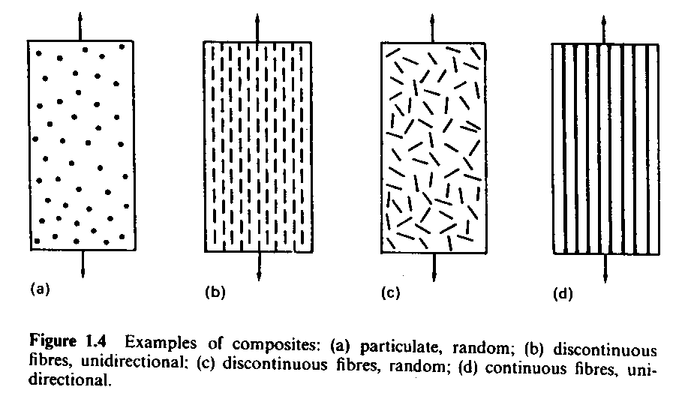

Slide 6
Fibers are the most common in composites and have the most influence on properties. Fiber has a length that is much greater than its diameter. The length-to-diameter (l/d) ratio is known as the aspect ratio and can vary greatly. Continuous fibers have long aspect ratios, the large aspect ratio of the fiber gives rise to effective shear stress transfer between the matrix and the reinforcement, while discontinuous fibers have short aspect ratios. Continuous-fiber composites normally have a preferred orientation, while discontinuous fibers generally have an aligned ( preferred) or random orientation. As shown in figure

Slide 7
Technologically, the most important composites are those in which the dispersed phase is in the form of a fiber. Design goals of fiber-reinforced composites often include high strength and/or stiffness on a weight basis. These characterizations are expressed in terms of specific strength and specific modulus parameters, which correspond, respectively, to the ratios of tensile strength to specific gravity and modulus of elasticity to specific gravity. Fiber-reinforced composites with exceptionally high specific strengths and moduli have been produced that use low-density fiber and matrix materials.

Slide 8
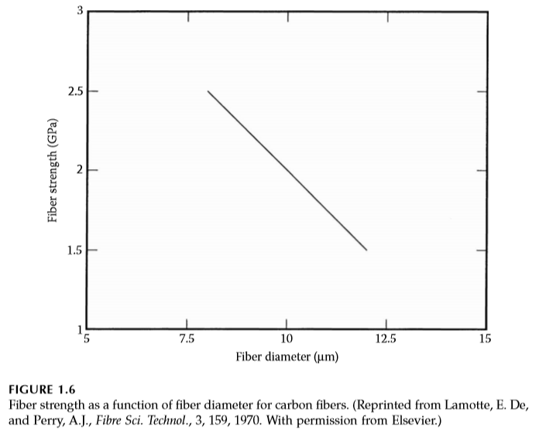
The main reasons for using ﬁbers of thin diameter are the following:
The actual strength of materials is several magnitudes lower than the theoretical strength. This difference is due to the inherent ﬂaws in the material. Removing these ﬂaws can increase the strength of the material. As the ﬁbers become smaller in diameter, the chances of an inherent ﬂaw in the material are reduced. A steel plate may have a strength of 100 ksi (689 MPa), while a wire made from this steel plate can have a strength of 600 ksi (4100 MPa). Figure 1.6 shows how the strength of a carbon ﬁber increases with the decrease in its diameter.

Slide 9
Fibers able to bend without breaking are required in the manufacturing of composite materials, especially for woven fabric composites. Ability to bend increases with a decrease in the ﬁber diameter and is measured as ﬂexibility.
Flexibility is deﬁned as the inverse of bending stiffness and is proportional to the inverse of the product of the elastic modulus of the ﬁber and the fourth power of its diameter.

Slide 10
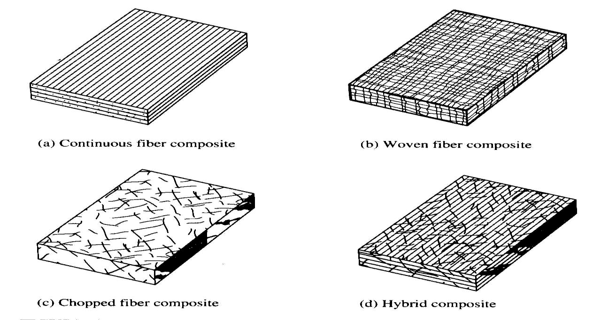
Types of Fiber-Reinforced Composites
One generally finds four types of fiber-reinforced composites as shown below . They differ in how the fibers are utilized to make the composite (orientation and length of fibers).

Slide 11
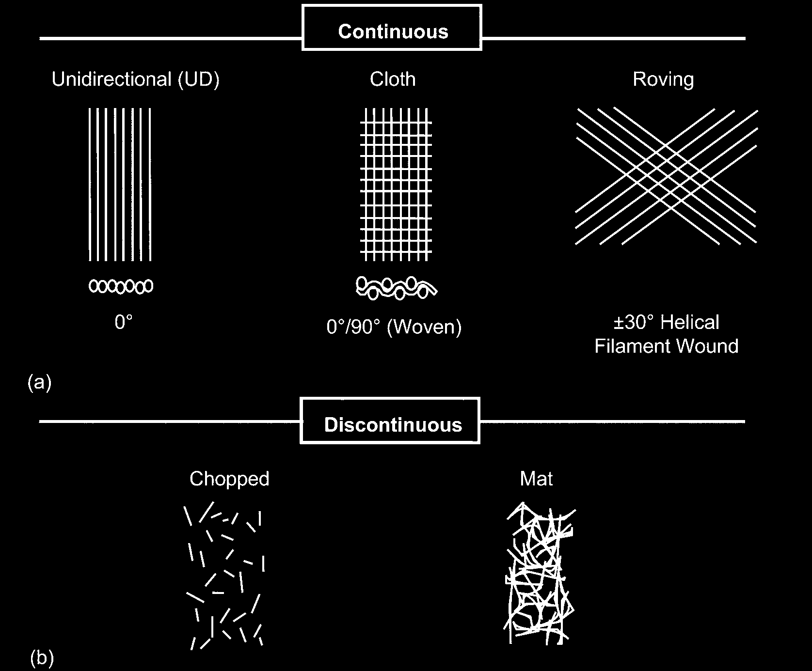

Slide 12
1- Continuous fiber composites are generally "laid-up" in plies (or laminae) with each ply having fibers oriented in the same direction. A layer of fibers all oriented in the same direction is embedded in a homogeneous material (called the matrix) to make a single ply or laminae. For example, glass-epoxy has a layer of glass fibers running more-or-less parallel within an epoxy resin matrix material.
2- Woven fiber composites are similar to ordinary cloth used in the textile industry. The woven fiber may be 2-D (fibers interwoven in 2 directions) or 3-D (fibers interwoven in 3 directions). Woven fiber composites do not generally have distinct laminae and are not nearly as susceptible to delamination; however, strength and stiffness are sacrificed due to the fact that the fibers are not as straight (because of the weaving) as in the continuous fiber laminate.

Slide 13
3- Chopped fiber composites have fibers that are relatively short and have a random orientation and distribution of fibers. Chopped fiber composites generally have mechanical properties that are considerably poorer than those of continuous fiber composites. However, they are cheaper to manufacture and are used in high-volume applications.
4- Hybrid composites generally consist of mixed chopped and continuous fibers; or mixed fiber types such as glass/graphite.
The mechanical characteristics of FRC depend on the following
1. Properties of fiber
2. Interfacial bond between fiber and matrix
3. Fiber length like longer gives continuous, shorter length gives discontinuous or random. Reinforcement efficiency of continuous is higher than short fibers.
4. Fiber orientation and concentration, if it is orderly orientation and continuous it is highly anisotropic or discontinuous or random orientation,

Slide 14
Continuous fibers have long aspect ratios, while discontinuous fibers have short aspect ratios. Continuous-fiber composites normally have a preferred orientation, while discontinuous fibers generally have a random orientation. examples of continuous reinforcements include unidirectional woven cloth, and helical winding, while examples of discontinuous reinforcements are chopped fibers and random mat . Continuous-fiber composites are often made into laminates by stacking single sheets of continuous fibers in different orientations to obtain the desired strength and stiffness properties with fiber volumes as high as 60 to 70 percent.
As the fibers become smaller in diameter, the chances of an inherent defect in the material are reduced.
Fibers produce high-strength composites because of their small diameter; they contain far fewer defects (normally surface defects) compared to the material produced in bulk.

Slide 15
As a general rule, the smaller the diameter of the fiber, the higher its strength, but often the cost increases as the diameter becomes smaller. In addition, smaller-diameter high-strength fibers have greater flexibility and are more amenable to fabrication processes such as weaving or forming over radii. typical fibers include glass, aramid, and carbon, which may be continuous or discontinuous.

Slide 16
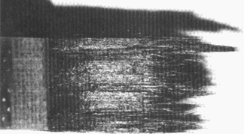
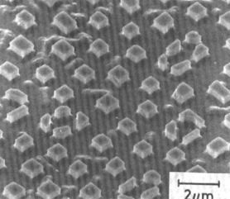
Classification: Fiber-Reinforced
Particle-reinforced
Fiber-reinforced
Structural
• Aligned Continuous fibers
• Examples:
-- Metal: γ'(Ni₃Al)-α(Mo)
by eutectic solidification.
-- Ceramic: Glass w/SiC fibers
formed by glass slurry
E_{glass} = 76 GPa; E_{SiC} = 400 GPa.
matrix:
α
(Mo) (ductile)
(a)
fracture
surface
2 μm
From F.L. Matthews and R.L. Rawlings, Composite Materials; Engineering and Science, Reprint ed., CRC Press, Boca Raton, FL, 2000. (a) Fig. 4.22, p. 145 (photo by J. Davies); (b) Fig. 11.20, p. 349 (micrograph by H.S. Kim, P.S. Rodgers, and R.D. Rawlings). Used with permission of CRC
Press, Boca Raton, FL.
fibers:
γ
’ (Ni₃Al) (brittle)
(b)
From W. Funk and E. Blank, “Creep deformation of Ni₃Al-Mo in-situ composites", Metall. Trans. A Vol. 19(4), pp. 987-998, 1988. Used with permission.

Slide 17
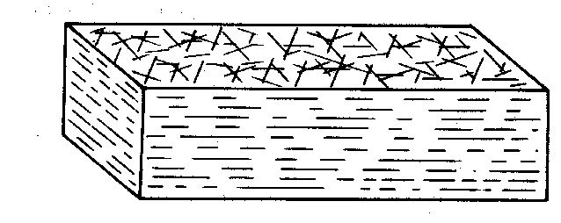
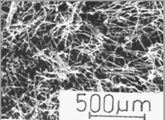
Classification: Fiber-Reinforced
Particle-reinforced
Fiber-reinforced
Structural
• Discontinuous fibers, random in 2 dimensions
• Example: Carbon-Carbon
-- fabrication process:
- carbon fibers embedded
in polymer resin matrix,
- polymer resin pyrolyzed
at up to 2500ºC.
-- uses: disk brakes, gas
turbine exhaust flaps,
missile nose cones.
C fibers:
very stiff
very
strong
(b)
500 μm
C matrix:
less stiff
view onto plane
less strong
fibers lie
(a)
in plane
• Other possibilities:
-- Discontinuous, random 3D
-- Discontinuous, aligned
Adapted from F.L. Matthews and R.L. Rawlings, Composite Materials; Engineering and Science, Reprint ed., CRC Press, Boca Raton, FL, 2000. (a) Fig. 4.24(a), p. 151; (b) Fig. 4.24(b) p. 151. (Courtesy I.J. Davies) Reproduced with permission of CRC Press, Boca Raton, FL.

Slide 18
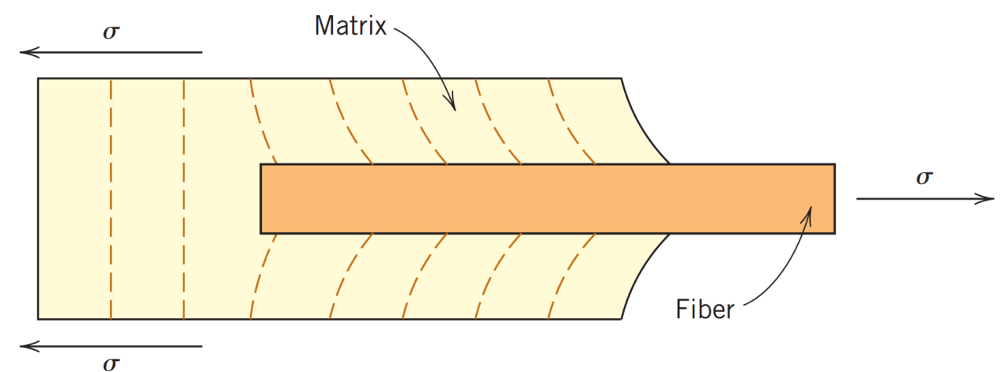
INFLUENCE OF FIBER LENGTH
The mechanical characterization of a fiber-reinforced composite depend not only on the properties of the fiber but also on the degree to which an applied load is transmitted to the fibers by the matrix phase. Important to the extent of this load transmittance is the magnitude of the interfacial bond between the fiber and matrix phases. Under applied stress, this fiber-matrix bond ceases at the fiber ends, yielding a matrix deformation pattern as shown in the figure below.
Fig. the deformation pattern in the matrix surrounding a fiber that is subjected to an applied tensile load

Slide 19
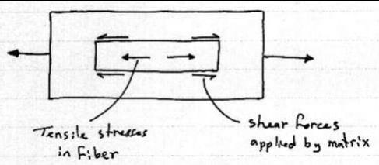
When a load is applied to a composite, it is applied to the matrix and transferred to the fibers by some combination of shear and tensile stresses acting across the interface.
The main difference between shear stress and tensile stress is that tensile stress refers to cases where a deforming force is applied at right angles to a surface, whereas shear stress refers to cases where a deforming force is applied parallel to a surface.

Slide 20
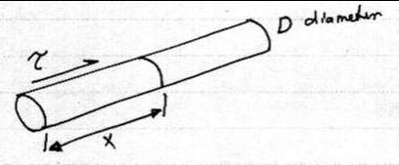
Consider the interfacial shear stress acting on a single fiber in a matrix in the following figure.
If ( τ ) is the average interfacial shear stress, then the shear force acting on a section of the fiber length ( x ) and of uniform cross-sectional diameter (D) is the:
Shear force =shear stress * area
= τ*πDx

Slide 21


This shear force is equal to normal force on the fiber, therefore
The stress increases from zero at the end of a fiber, i.e. When (x=0), to its maximum possible value when (X= 0.5* Lc).
Hence , the maximum value of the tensile stresses is given by:
𝑴𝒂𝒙𝒊𝒎𝒖𝒎 𝝈𝒇 = 𝟐∗𝝉∗𝑳𝒄

Slide 22

Then the critical fiber length (Lc), for any given fiber diameter (D) can be determined:
(τ ) is the average interfacial shear stress
(D)cross-sectional diameter
(𝜎f) ultimate (or tensile) strength
Some critical fiber length is necessary for effective strengthening and stiffening of the composite material.
This critical length lc is dependent on the fiber diameter (d) and its ultimate (or tensile) strength (𝜎_{f}), and on the fiber–matrix bond strength (or the shear strength of the matrix.

Slide 23
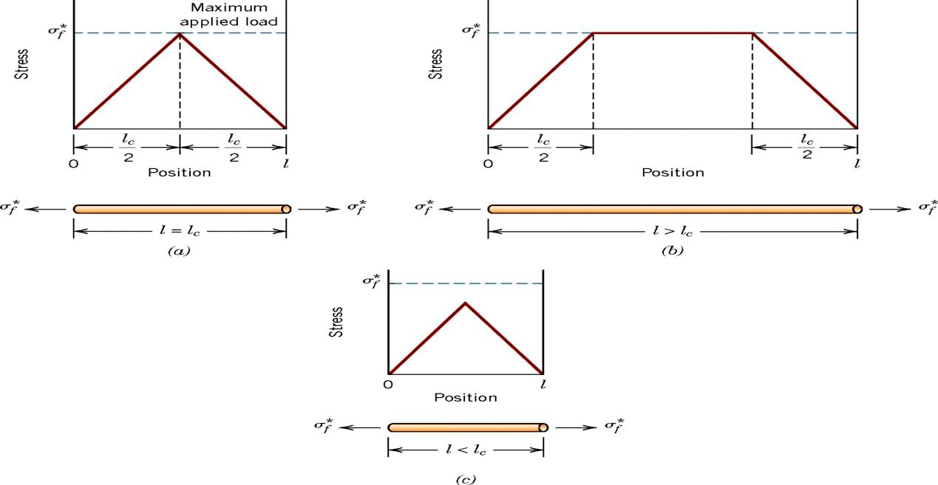

Slide 24
1. l = lc , the maximum fiber load is achieved only at the axial center of
the fiber.
2. l > lc , as fiber length increases, the fiber reinforcement becomes more effective. Therefore, fiber normally have length > 15lc .
3. l < lc , the matrix deforms around the fiber such that there is no stress transference and little reinforcement by the fiber

Slide 25
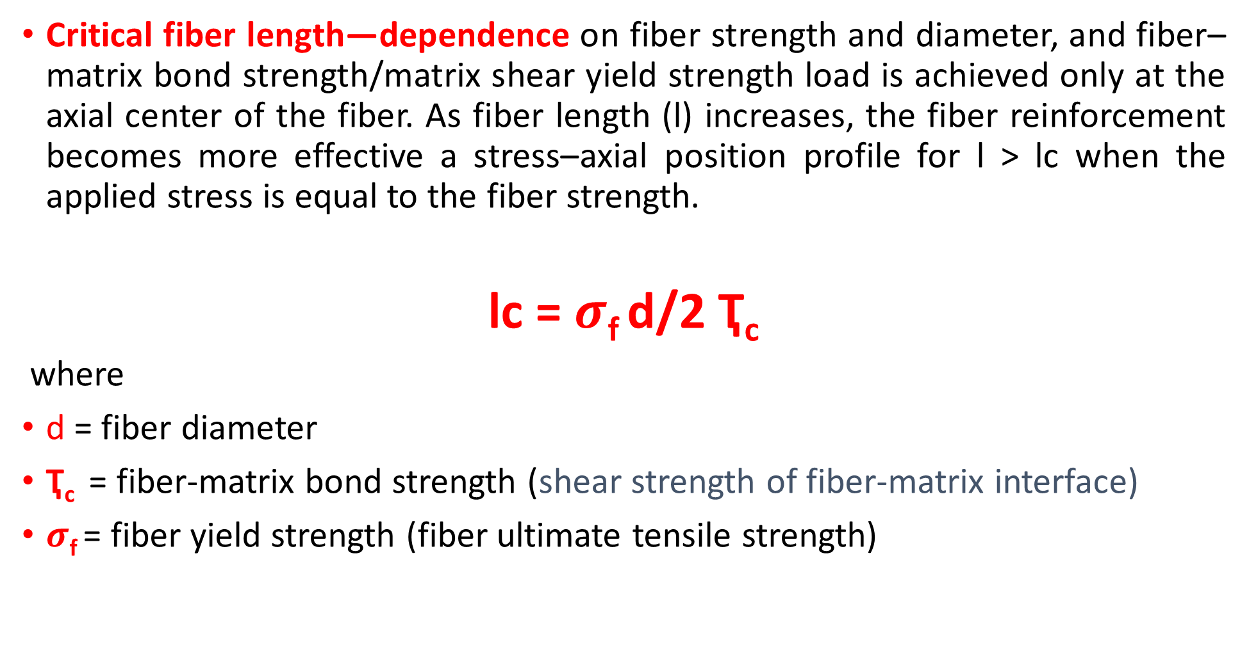
Critical fiber length—dependence on fiber strength and diameter, and fiber–matrix bond strength/matrix shear yield strength load is achieved only at the axial center of the fiber. As fiber length (l) increases, the fiber reinforcement becomes more effective a stress–axial position profile for l ˃ lc when the applied stress is equal to the fiber strength.
lc = $σ$_{f} d/2 Ҭ_{c}
where
d = fiber diameter
Ҭ_{c} = fiber-matrix bond strength (shear strength of fiber-matrix interface)
$σ$_{f} = fiber yield strength (fiber ultimate tensile strength)

Slide 26
Classification: Fiber-Reinforced
Particle-reinforced
Fiber-reinforced
Structural
• Critical fiber length for effective stiffening & strengthening:
fiber ultimate tensile strength
fiber diameter
shear strength of fiber-matrix interface
• Ex: For fiberglass, common fiber length > 15 mm needed
• For longer fibers, stress transference from matrix is more efficient
Short, thick fibers:
Long, thin fibers:
Low fiber efficiency
High fiber efficiency

Slide 27

Example (1) A glass fiber polyester composite contains (60%) by volume of fibers. The fibers being of length (3mm) with diameter (0.005mm). If the failure stress for the fibers is (1500 MPa), the shear strength (25 MPa), and the matrix has a tensile strength of (50 MPa) . Determine Critical length of the fiber.
Solution

Slide 28
INFLUENCE OF FIBER ORIENTATION AND CONCENTRATION
The arrangement or orientation of the fibers relative to one another, the fiber concentration, and the distribution all have a significant influence on the strength and other properties of fiber-reinforced composites. With respect to orientation, two extremes are possible:
(1) a parallel alignment of the longitudinal axis of the fibers in a single direction.
(2) a totally random alignment.
(3) some combination

Slide 29
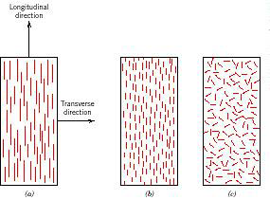
Schematic representations of (a) continuous and aligned, (b) discontinuous and aligned, and (c) discontinuous and randomly oriented fiber–reinforced composites.
Continuous fibers are normally aligned whereas discontinuous fibers may be aligned randomly oriented or partially oriented. Better overall composite properties are realized when the fiber distribution is uniform.

Slide 30
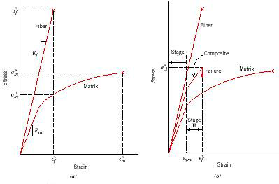

Slide 31
The effects of arrangement or orientation of the fibers on composite properties
Stage I - elastic deformation with intermediate
Stage II - matrix yields
Failure - Non-catastrophic. When fibers fracture, you now have a new fiber length and a matrix is still present.

Slide 32
Four ﬁber factors contribute to the mechanical performance of a
composite are :
1- Length: The ﬁbers can be long or short. Long, continuous ﬁbers are easy to orient and process, but short ﬁbers cannot be controlled fully for proper orientation. Long ﬁbers provide many beneﬁts over short ﬁbers. These include impact resistance, low shrinkage, improved surface ﬁnish, and dimensional stability. However, short ﬁbers provide low cost, are easy to work with, and have fast cycle time fabrication procedures. Short ﬁbers have fewer ﬂaws and therefore have higher strength.
2- • Shape: The most common shape of ﬁbers is circular because handling and manufacturing them is easy. Hexagon and square-shaped ﬁbers are possible, but their advantages of strength and high packing factors do not outweigh the difﬁculty in handling and processing.

Slide 33
3- Orientation: Fibers oriented in one direction give very high stiffness and strength in that direction. If the ﬁbers are oriented in more than one direction, such as in a mat, there will be high stiffness and strength in the directions of the ﬁber orientations. However, for the same volume of ﬁbers per unit volume of the composite, it cannot match the stiffness and strength of unidirectional composites.
4- Material: The material of the ﬁber directly inﬂuences the mechanical performance of a composite. Fibers are generally expected to have high elastic moduli and strengths. This expectation and cost have been key factors in the graphite, aramids, and glass dominating the ﬁber market for composites.

Slide 34
Effect of fiber orientation on the tensile strength of E-glass fiber-reinforced epoxy composites.
Glass is a common reinforcement
- it is easily drawn into fibers
- it is cheap and readily available
- it is easy to process into composites
-it can produce very strong, very light composites (high specific strength) it is usually chemically inert (does not degrade in environments)
When fibers are aligned
1- properties of the material are highly anisotropic modulus in direction of alignment is a function of the volume fraction of the modulus of the fiber and matrix
2- modulus perpendicular to the direction of alignment is considerably less (the fibers do not contribute)

Slide 35
When fibers are randomly
1- Properties are isotropic
2- not dependent on the direction
3- Ultimate tensile strength is less than for aligned fibers
Fiber Materials
Glass fibers consist primarily of silica (silicon dioxide) and metallic-oxide-modifying elements are generally produced by the mechanical drawing of molten glass through a small orifice. E-glass accounts for most of the glass fiber production and is the most widely used reinforcement for composites. The second most popular glass fiber, S-glass, has roughly 30 percent greater tensile strength and 20 percent greater modulus of elasticity than E-glass but is not as widely used because of its higher cost.

Slide 36
Graphite or carbon fibers are the most widely used advanced fiber, and graphite/epoxy or carbon/epoxy composites are now used routinely in aerospace structures. The actual fibers are usually produced by subjecting organic precursor fibers such as polyacrylonitrile (PAN) or rayon to a sequence of heat treatments so that the precursor is converted to carbon by pyrolysis. Graphite fibers are typically subjected to higher heat treatments than carbon fibers. Carbon fibers are typically 90-95% carbon, whereas graphite fibers are at least 99% carbon.
Aramid polymer fibers, produced primarily by E.I. duPont deNemours & Company under the tradename "Kevlar," were originally developed for use in tires. The density of Kevlar is about half that of glass and its specific strength is among the highest of currently available fibers. Kevlar also has excellent toughness, ductility, and impact resistance; unlike brittle glass or graphite fibers.

