Slide 1
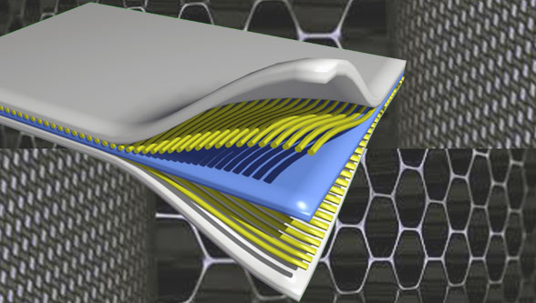
Composite Materials
Dr. Abbas Hasan Faris
Lecture 6

Slide 2
Classification: Fiber-Reinforced (v)
Particle-reinforced
Fiber-reinforced
Structural
• Critical fiber length for effective stiffening & strengthening:
fiber ultimate tensile strength
fiber diameter
shear strength of
fiber-matrix interface
• Ex: For fiberglass, a common fiber length > 15 mm needed
• For longer fibers, stress transference from the matrix is more efficient
Short, thick fibers:
Long, thin fibers:
Low fiber efficiency
High fiber efficiency

Slide 3
Mechanical Properties of Fiber-Reinforced Composites
Tensile Stress-Strain Behavior:
Elastic behavior-Transverse loading (continuous and aligned fiber composite)
a continuous and oriented fiber composite may be loaded in the transverse direction. That is, the load is applied at a 90º angle to the direction of fiber alignment.
Composite Stiffness: Transverse Loading
For longitudinal loading, isostrain conditions are assumed where the deformation of the fibers and matrix are identical. In this assumption, there are stiff and strong mechanical properties.
For transverse loading, isostress conditions are assumed where the matrix and fibers are under the same stress (σc = σf = σm). In this assumption, the mechanical properties are considered soft and weak.

Slide 4
Transverse loading is a load applied vertically to the plane of the longitudinal axis of a configuration. It causes them to bend and rebound from their original position. (Exposed stresses are same: isostress state)

Slide 5
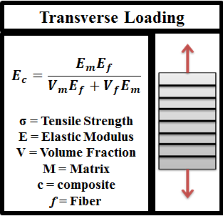
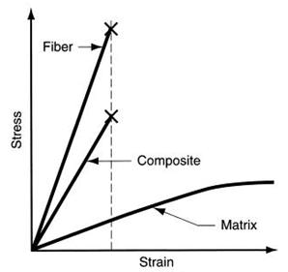

Slide 6
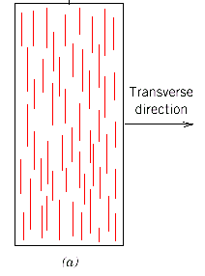
Composite Stiffness: Transverse Loading
In transverse loading, the fibers carry less of the load
ε_{c}= ε_{m}V_{m} + ε_{f}V_{f} and σ_{c} = σ_{m} = σ_{f} = σ
isostress
∴
E_{ct} = transverse modulus
c = composite f = fiber
m = matrix

Slide 7
It has been stated previously that an increase in the volume fraction of fibers in composite results in an increase in stiffness. it can be seen how the volume fraction of fibers affects the modulus of the composite in both the isostrain and isostress conditions. The modulus in the isostrain condition is linearly related to the volume fraction of fibers. In the isostress condition, the relationship is not linear. Note how the isostress condition never produces a value of modulus higher than that obtained in the isostrain condition.

Slide 8
For this situation, the stress (σ) of the composite, as well as both phases, are exposed the same:
𝜎_{𝑐} = 𝜎_{𝑚} = 𝜎_{𝑓} = 𝜎 ---------------(1) (𝜎 is the tensile strength (TS))
This is termed an isostress state. Also, the strain or deformation of the entire composite (ε_{c}) is:
𝜀_{𝑐} = 𝜀_{𝑚}𝑉_{𝑚} + 𝜀_{𝑓}𝑉_{𝑓} ---------------(2)
But, because ε = σ/E
$\frac{\text{σ}}{\text{E}c}=\frac{\text{σ}}{\text{E}m}Vm+\frac{\text{σ}}{\text{E}f}$ V_{f} -----------(3)
Now, dividing by (σ) yields:
$\frac{\text{1}}{\text{E}c}=\frac{\text{V}\text{m}}{\text{E}m}+\frac{\text{V}\text{f}}{\text{E}f}$ ------------------(4)
Which reduces to:
E_{c} = $\frac{\text{E}m\text{E}f}{\text{v}m\text{E}f+Vf\text{E}m}$ ----------------(5)

Slide 9
Example:
Compute the elastic modulus of the composite material described (A continuous and aligned glass fiber-reinforced composite consists of 40 vol % of glass fibers having a modulus of elasticity of 69 GPa and 60 vol % of a polyester resin that, when hardened, displays a modulus of 3.4 GPa).
but assume that the stress is applied perpendicular to the direction of fiber alignment.
Solution
According to equation 5,
E_{c} = $\frac{\text{E}m\text{E}f}{\text{v}m\text{E}f+Vf\text{E}m}$
E_{c} = $\frac{\left(3.4 GPa\right)(69 GPa)}{\left(0.6\right) \left(69 GPa\right)+\left(0.4\right) (3.4 GPa)}$
= 5.5 Gpa
From this Example, this value is only one-fifth of the modulus of elasticity along the fiber direction, which indicates the degree of anisotropy of continuous and oriented fiber composite.

Slide 10
Composite Stiffness: Longitudinal Loading
Continuous fibers - Estimate fiber-reinforced composite modulus of elasticity for continuous fibers
Longitudinal deformation
σ_{c} = σ_{m}V_{m} + σ_{f}V_{f} and ε_{c} = ε_{m} = ε_{f}
volume fraction isostrain
E_{cl} = E_{m}V_{m} + E_{f} V_{f} E_{cl} = longitudinal modulus
c = composite f = fiber
m = matrix

Slide 11
Continuous fibers - Estimate fiber-reinforced composite modulus of elasticity for continuous fibers
1- Longitudinal tensile strength for continuous and aligned fibrous composite
Under longitudinal load, strength is normally taken as the maximum stress on the stress-strain curve, which corresponds to fiber fracture and marks the onset of composite failure.
Assume 𝜀*_{f} < 𝜀*_{m} , the fibers will fail before the matrix. Then:
𝜎*_{c} = 𝜎*_{m} (1 — V_{f} ) + 𝜎*_{f} V_{f}
𝜎*_{m} is the stress in the matrix at fiber failure,
𝜎*_{𝑓} is the fiber tensile strength.

Slide 12
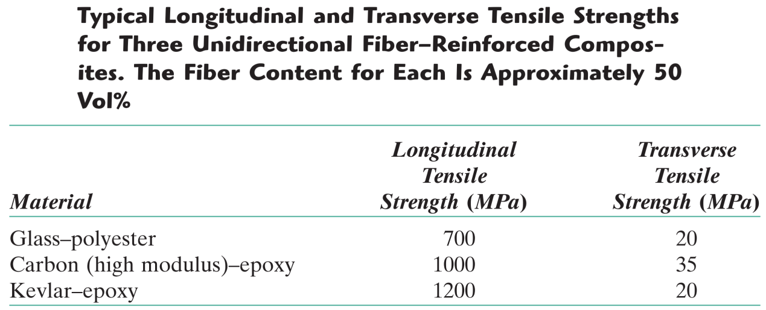

Slide 13
2- Longitudinal tensile strength for discontinuous and aligned fibrous composite, and l > lc
For a discontinuous and aligned-fiber composite having a uniform distribution of fibers and in which l > lc , the longitudinal strength (σc*) is given by:
$\text{σ}\text{c}\text{∗}=\text{σ}\text{f}\text{∗}\text{Vf}\left(1—\frac{\text{lc}}{2\text{l}}\right)+\text{σ}\text{f}\text{m} \text{(}\text{1}—Vf)$
Where 𝜎_{𝑓}∗ and 𝜎_{𝑚}′ are the fracture strength of the fiber and the stress in the matrix when the composite fails.

Slide 14
3- Longitudinal tensile strength for discontinuous and aligned fibrous composite, and l < lc
If the fiber length is less than critical (l < lc), then the longitudinal strength (𝜎_{c}∗) is given by:
$\text{σ}\text{c}\text{∗}=\left(\frac{\text{l}\text{τ}\text{c}}{d}\right)\text{V}\text{f}+\text{σ}\text{f}\text{m} \text{(}\text{1}—Vf)$
Where d is the fiber diameter and τ_{c} is the interfacial shear stress.
4- Discontinuous and randomly oriented-fiber composite
When the fiber orientation is random, short and discontinuous fibers are used. Under these cases, a (rule of mixtures) expression for the elastic modulus may be used:
𝐸_{𝑐} = 𝐾𝐸_{𝑓}𝑉_{𝑓} + 𝐸_{𝑚}𝑉_{𝑚}

Slide 15
Where K is a fiber efficiency parameter that depends on Vf and the Ef/Em ratio.
Of course, its magnitude will be less than unity, usually in the range of 0.1 to 0.6.
Example 3
Compute the longitudinal tensile strength of an aligned glass fiber-epoxy matrix composite in which the average fiber diameter and length are 0.010 mm and 2.5 mm, respectively, and the volume fraction of fibers is 0.40. Assume that:
1. the fiber-matrix bond strength (shear strength) is 75 MPa,
2. the fracture strength of the fibers is 3500 MPa,
3. the matrix stress at fiber failure is 8.0 MPa.

Slide 16
Solution:
𝑙c = $\frac{\text{σ}\text{f}\text{∗} \text{d}}{\text{2}\text{τ}\text{c}}$ = $\frac{\text{(}\text{3500 }\text{MPa}\text{)(}\text{0.}\text{010 }\text{mm}\text{)}}{\text{2 }\text{(}\text{75 }\text{MPa}\text{)}}$ = $\frac{\text{7}}{\text{30}}$ mm
Ic = 0.233 mm
Since the critical fiber length of 0.233 mm is much less than the provided length of the fiber (2.5mm) , so we can use the following equation to find the longitudinal tensile strength. l >lc
$\text{σ}\text{c}\text{∗}=\text{σ}\text{f}\text{∗}\text{Vf}\left(1—\frac{\text{lc}}{2\text{l}}\right)+\text{σ}\text{f}\text{m} \text{(}\text{1}—Vf)$
$\text{σ}\text{c}\text{∗}=\text{3500 }\text{MPa}\text{ ∗ }\text{0.4}\left(1—\frac{\text{7}\text{/}\text{30}}{2\text{∗}2.5 mm}\right)+\text{8 }\text{MPa}\text{ ∗}$ 0.6 = 1340 MPa
The longitudinal tensile strength of the aligned glass fiber-epoxy matrix composite is 1339.47 MPa

Slide 17
Example 4
Consider a uniaxial fiber reinforced composite of aramid fibers in an epoxy matrix. The volume fraction of fibers is (60 %) . The composite is subjected to an axial strain of (0.1 %) . Compute the modulus and strength along the axial direction of the composite, Ef=140 GPa, Em= 5 GPa.
Solution
𝐸_{𝑐} = 𝐸_{𝑚}(1 − 𝑉_{𝑓}) + 𝐸_{𝑓} 𝑉_{𝑓}
= 5(1- 0.6) + 140* 0.6
= 86 GPa
𝜎_{𝑐} = 𝐸_{𝑐}𝜀_{𝑐}
= 86 * 0.001* 1000 = 86 MPa

Slide 18
Example 5
A composite material has a longitudinal modulus of elasticity of (18.2 GPa). Containing unidirectional S – glass fibers in on epoxy matrix.
Determine,
a) Volume fraction of glass fiber and the epoxy matrix.
b) The density of the composite.
Note :- Density of epoxy = 1.3 gm/cm³ , Density of glass = 2.2 gm/cm³
Modulus of epoxy = 2.75 GPa.
Modulus of glass =380 GPa.

Slide 19
Solution
a)
𝐸_{𝑐} = 𝐸_{𝑚}(1 − 𝑉_{𝑓}) + 𝐸_{𝑓} 𝑉_{𝑓}
18.2 = 2.75 (1 − 𝑉_{𝑓})+ 380 * V_{f}
V_{f} = 0.041, V_{m} = 0.959
b)

Slide 22
Density of Composite
Density of Composite in terms of weight fraction
Density of Composite in terms of Volume fraction

