Slide 1
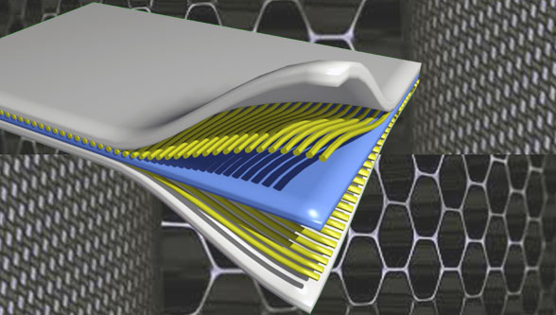
Composite Materials
Dr. Abbas Hasan Faris
Lecture-12

Slide 2
Characterization of Composite Materials
The composites have major applications in advanced fields such as structure, thermal engines, blades, automobiles, aerospace, rocket, and missiles. The characterization of a composite is one of the essential tasks for developing the desired composite products for particular applications.
Composite material characterization is a vital part of the product development and production process. Physical and chemical characterization helps developers to further their understanding of products and materials, thus ensuring quality control.
The major characterization studies used for composites for the evaluation of performance in the targeted areas are mechanical, thermal, electrical, magnetic, piezoelectric, tribological, rheological, and biological.

Slide 3
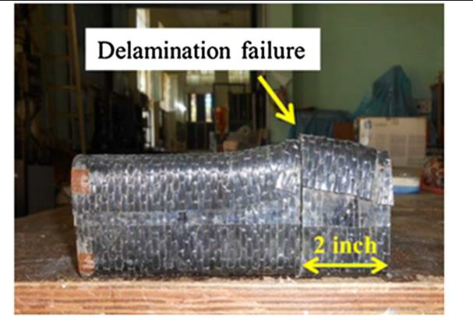
Volume Fraction
In a composite material, the parameter “volume fraction” plays a major role in characterizing its various properties such as mechanical, thermal, electrical, etc. The fiber volume fraction determines the strength of the composites.
Delamination is the major damage noticed for specimens with higher fiber volume percent,

Slide 4
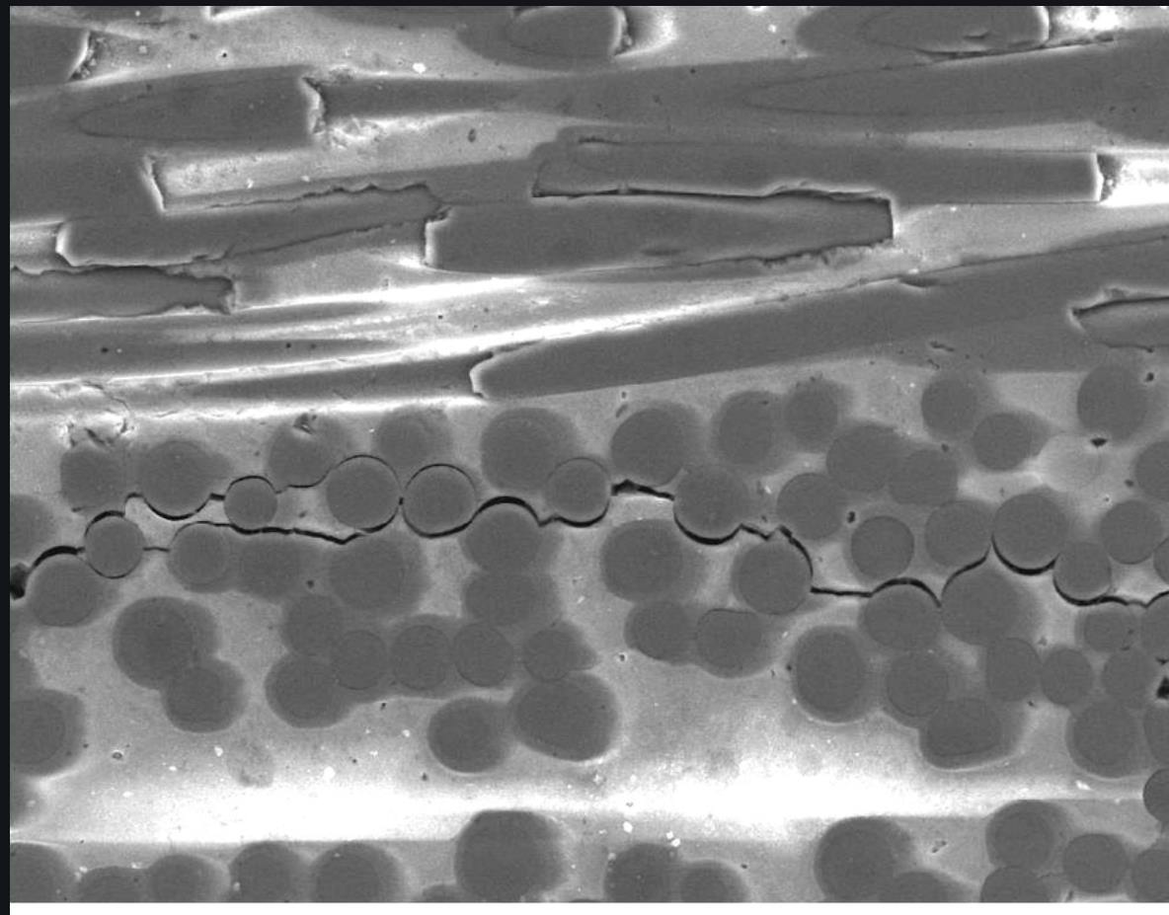
while the matrix cracking and interface debonding occur for materials with low fiber volume percent.
The fiber volume fraction (Vf) can be written in terms of fiber weight fraction(Wf) as:

Slide 5
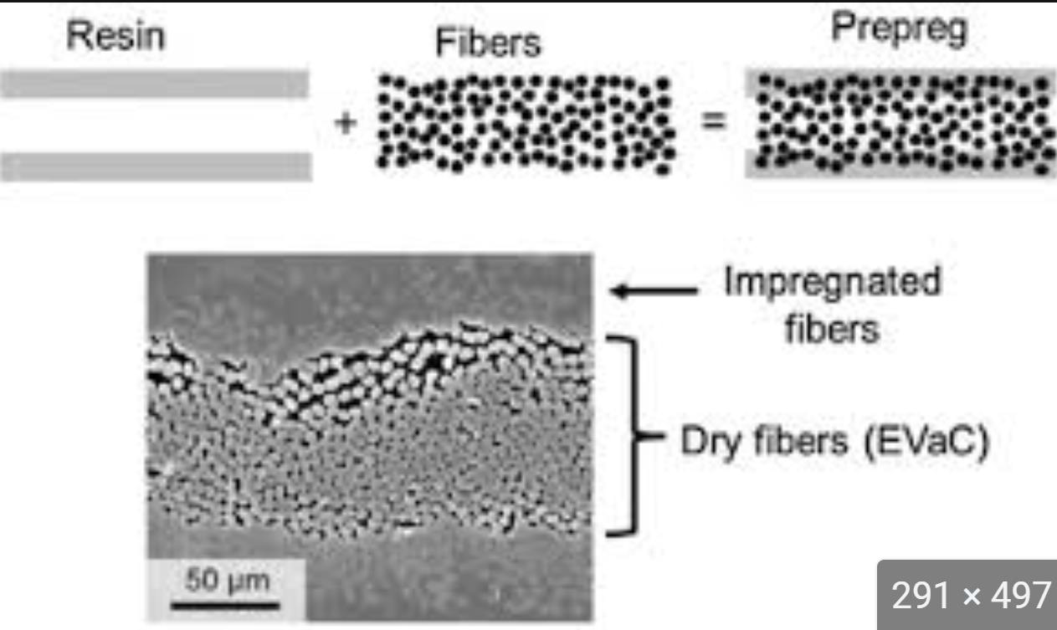
Where ρm, ρf, Wf, and Wm are the density of the matrix, the density of the fiber, the weight fraction of the fiber, and the weight fraction of the matrix, respectively.
The fiber volume percent of a composite are determined by chemical matrix digestion method, the burn test, or by photomicrographic techniques.
2. Voids
Voids form at the interface of composite structures.

Slide 6
These are generally formed as gas bubbles trapped inside the cured composite materials. The primary sources of voids include the material constituents and the synthesis processes.
Void is undesirable and has an adverse effect on the mechanical properties of composites. Void area greater than 0.03 mm2 results in the deterioration of mechanical properties.The equation for determining the volume fraction of the void is given as:
Where is the experimentally determined composite density.

Slide 7
3. Surface Roughness
Surface roughness is an important parameter for ascertaining surface quality and aesthetic value. The average surface roughness (Ra value) is one of the most frequently used parameters for surface roughness, which describes the height of irregularities and gives an indirect indication of the sharpness and depth of surface notches. Researchers have used this Ra value for studying the impacts of various process parameters on the surface quality of FRP(fiber-reinforced polymer composites) composites.
4. Surface Topography
Scanning electronmicroscope (SEM)
is also used for studying the topography of solids. In the field of FRPs, it is used to reveal the actual distribution of fibers and matrix in the composite. It is also used for the analysis of fractured surfaces and helps to examine the crack propagation in fibrous composite materials in order to gain an insight into composite strength, the adhesion between the phases, and the mode of failure.

Slide 9
5. Mechanical properties
The mechanical properties of composites include (i) strain and yield strength in tension, compression, shear, and torsion, (ii) ILSS (Interlaminar Shear Strength ) between the matrix and fiber, (iii) flexural fatigue strength, (iv) impact strength, (v) stress relaxation, and (vi) creep.
6. Thermal properties
Thermal characterization is very important to achieve precise measurements before the application. The thermal behavior of composite materials is evaluated based on the coefficient of thermal expansions (CTEs). The CTEs are given by Eq:

Slide 10
Where α_{l}, α_{fl}, E_{fl}, α_{m}, E_{m}, are the coefficient of thermal expansion in the longitudinal direction, the coefficient of thermal expansion of fibers in the longitudinal direction, the modulus of fibers in the longitudinal direction, the coefficient of thermal expansion of the matrix, the mod++++ulus of the matrix.
Similarly, the longitudinal thermal conductivity of the composite can be written as:
where K_{l}, K_{fl}, and K_{m} are the thermal conductivity of the composite in the longitudinal direction, the thermal conductivity of fibers in the longitudinal direction, the thermal conductivity of the matrix, respectively.

Slide 11
Glass Transition Temperature:
Glass transition temperature (denoted by“Tg”) is the temperature at which a material experiences a significant change in properties from hard and brittle to soft and pliable.
At glass transition temperature, the polymeric structure turns “rubbery” upon heating and“glassy” upon cooling. It is to be noted that in the case of low Tg materials, in order to achieve the benefit of the orientation enhancement effect, the Tg should be in the vicinity of or lower than the measuring temperature.

Slide 12
7. Electrical properties
It has been shown that the composite structure using an insulating a polymer as the host matrix improves the physical and chemical properties of electrically conductive polymers (ECPs).
In the high-temperature region, the electrical conductivity (σ) of the films is found to follow the equation given below :
where E_{a}, T, and k are the activation energy, absolute temperature, and Boltzmann constant, respectively. It has been reported that the mechanical properties of the conductive composites can be improved with a decrement in electrical conductivity.

Slide 13
8. Biological properties
Biological characterizations of composite materials include toxicity and degradation testing procedures, which are most important in biological applications. The interphases of such composites are particularly important in the case of bio-related applications; hence, their properties in terms of biocompatibility, biodegradability, and bioactivity have to be well understood before practical applications.

