Slide 1
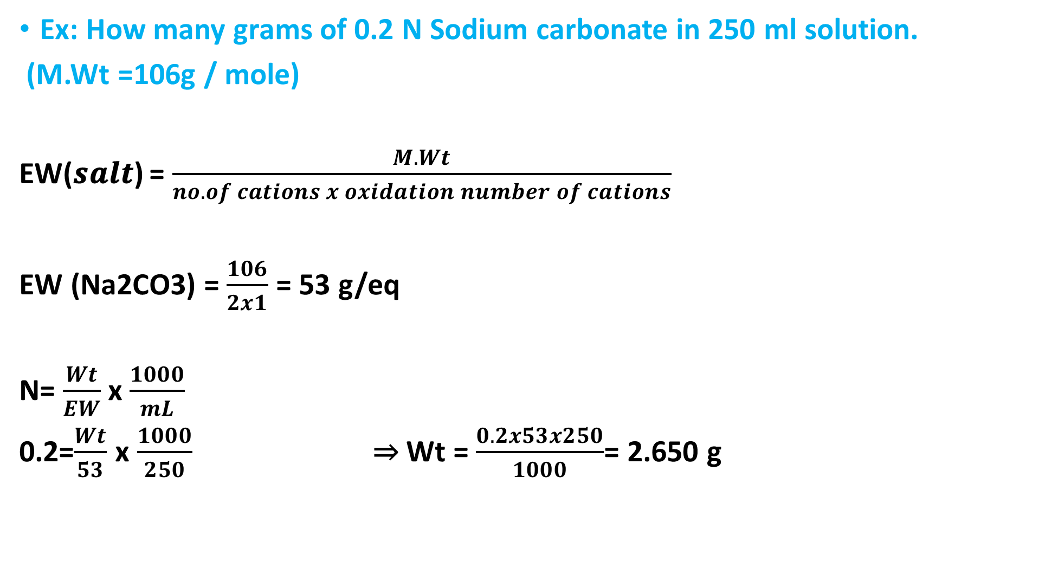
Ex: How many grams of 0.2 N Sodium carbonate in 250 ml solution.
(M.Wt =106g / mole)
EW(𝒔𝒂𝒍𝒕) = $\frac{M.Wt}{no. of cations x oxidation number of cations}$
EW (Na2CO3) = $\frac{106}{2x1}$ = 53 g/eq
N= $\frac{Wt}{EW}$ x $\frac{1000}{mL}$
0.2=$\frac{Wt}{53}$ x $\frac{1000}{250}$ ⇒ Wt = $\frac{0.2x53x250}{1000}$= 2.650 g

Slide 2
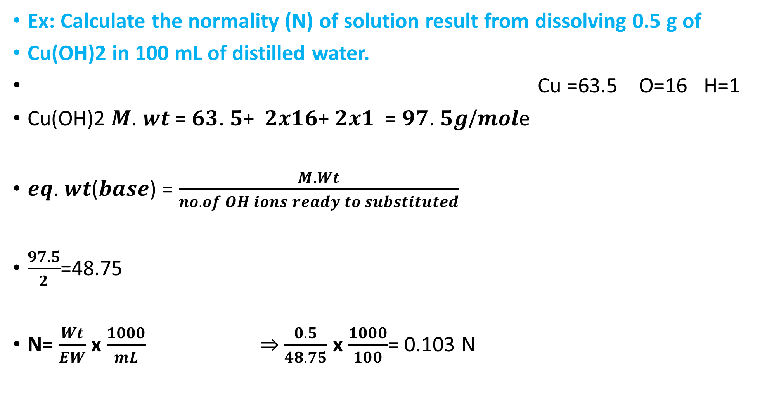
Ex: Calculate the normality (N) of solution result from dissolving 0.5 g of
Cu(OH)2 in 100 mL of distilled water.
Cu =63.5 O=16 H=1
Cu(OH)2 𝑴. 𝒘𝒕 = 𝟔𝟑. 𝟓+ 𝟐𝒙𝟏𝟔+ 𝟐𝒙𝟏 = 𝟗𝟕. 𝟓𝒈/𝒎𝒐𝒍e
𝒆𝒒. 𝒘𝒕(𝒃𝒂𝒔𝒆) = $\frac{M.Wt}{no. of OH ions ready to substituted}$
$\frac{97.5}{2}$=48.75
N= $\frac{Wt}{EW}$ x $\frac{1000}{mL}$ ⇒ $\frac{0.5}{48.75}$ x $\frac{1000}{100}$= 0.103 N

Slide 3
Example: Calculate the analytical and equilibrium molar concentrations of the solute species in an aqueous solution that contains 285 mg of trichloroacetic acid, Cl₃CCOOH (163.4 g/mol), in 10.0 mL (the acid is 73% ionized in water).
• Solution: we calculate the number of moles of Cl₃CCOOH, which we symbolize, as HA, and divide by the volume of the solution, 10.0 mL, or 0.0100 L.
Therefore,

Slide 4
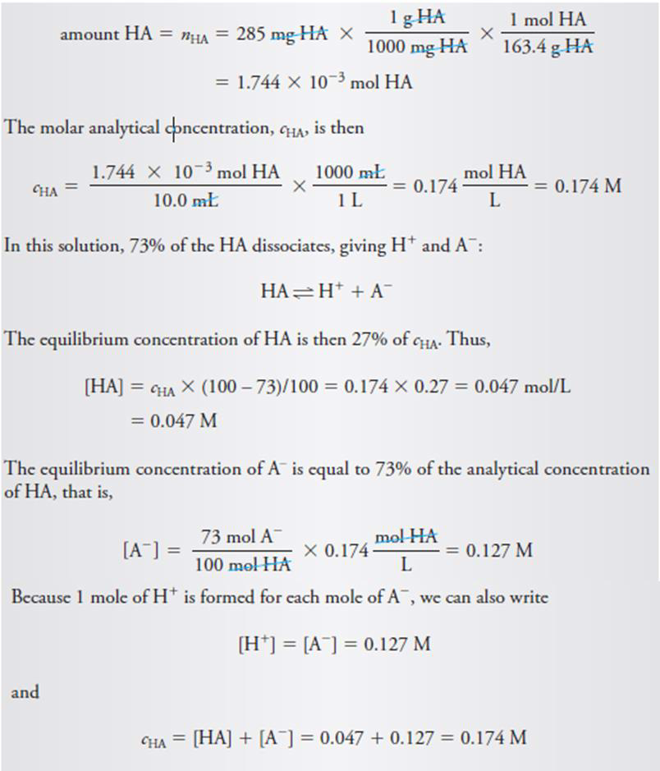

Slide 5
Example: Describe the preparation of 2.00 L of 0.10 M Na2CO3 (106g/mol) from the solid?
mol Na₂CO₃ needed = 0.1mol/L x 2L= 0.2 mol
mass Na₂CO₃ = 0.2 mol x 106 g/mol =21.2g
Dissolve 21.2g of Na₂CO₃ in distilled water and dilute to 2L.

Slide 6
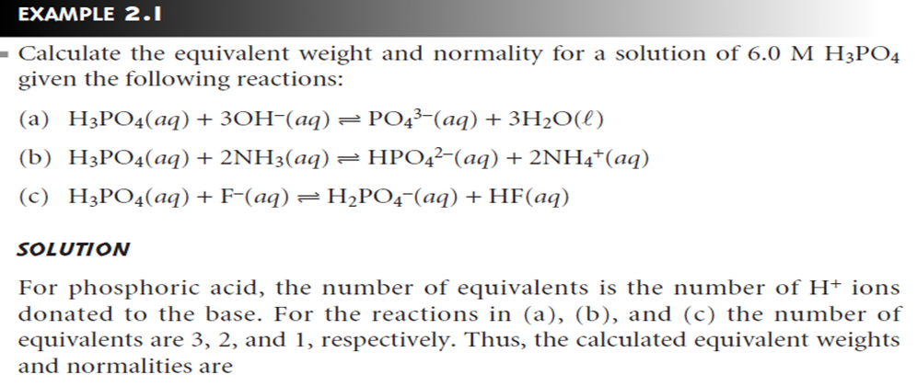

Slide 7
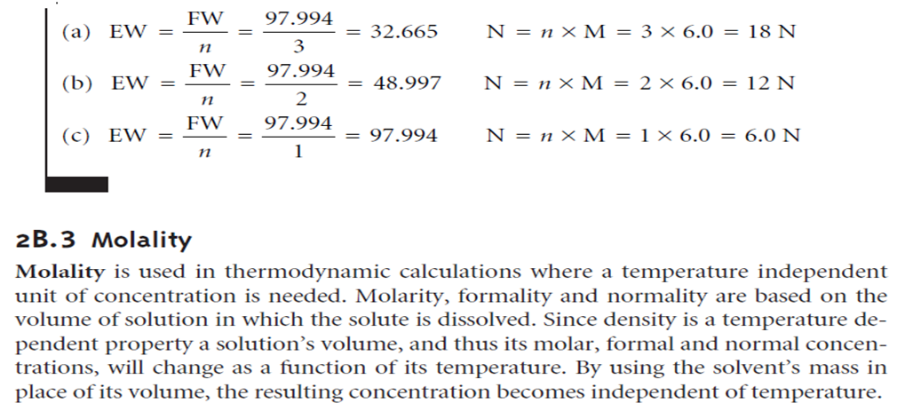

Slide 8
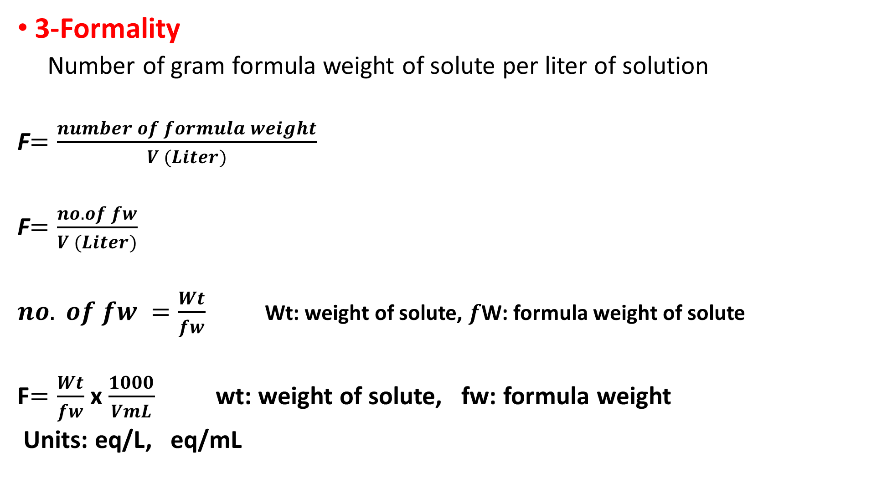
3-Formality
Number of gram formula weight of solute per liter of solution
F$=\frac{number of formula weight}{V (Liter)}$
F$=\frac{no. of fw}{V (Liter)}$
$no. of fw =\frac{Wt}{fw}$ Wt: weight of solute, $f$W: formula weight of solute
F$=\frac{Wt}{fw}$ x $\frac{1000}{VmL}$ wt: weight of solute, fw: formula weight
Units: eq/L, eq/mL

Slide 9
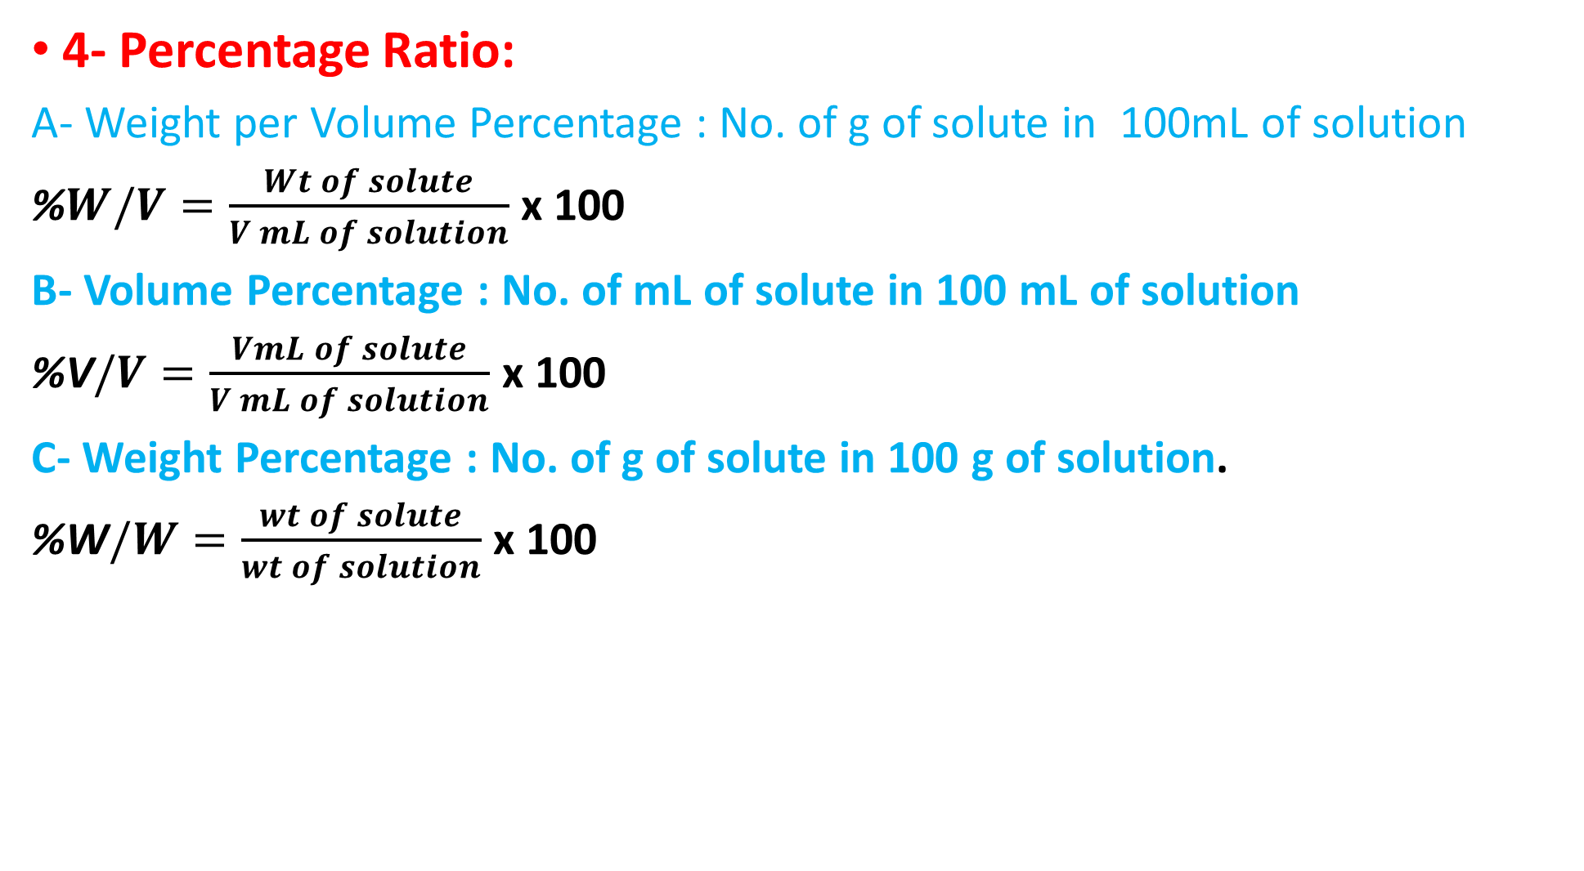
4- Percentage Ratio:
A- Weight per Volume Percentage : No. of g of solute in 100mL of solution
%$W/V=\frac{Wt of solute}{V mL of solution}$ x 100
B- Volume Percentage : No. of mL of solute in 100 mL of solution
%V$/V=\frac{VmL of solute}{V mL of solution}$ x 100
C- Weight Percentage : No. of g of solute in 100 g of solution.
%W$/W=\frac{wt of solute}{wt of solution}$ x 100

Slide 10
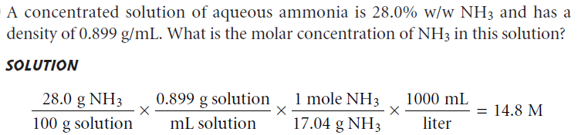
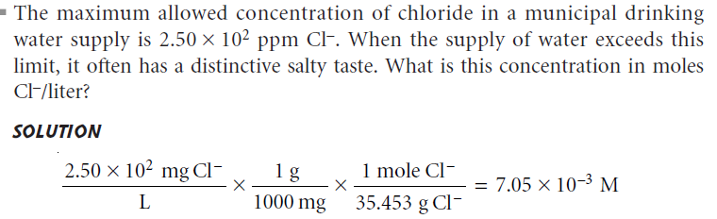

Slide 11
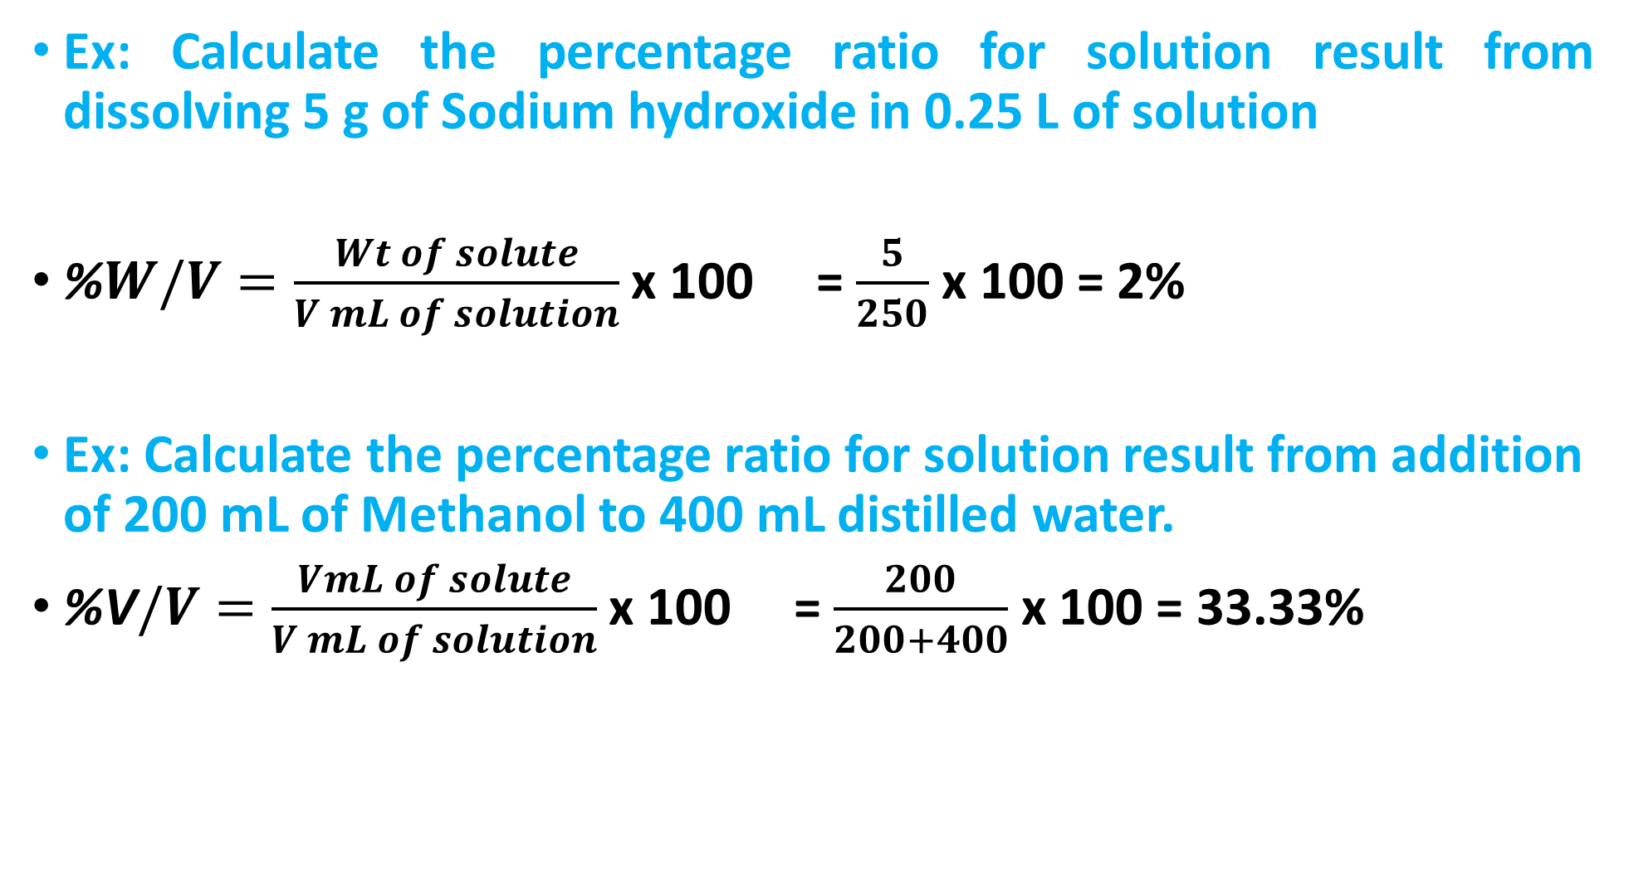
Ex: Calculate the percentage ratio for solution result from dissolving 5 g of Sodium hydroxide in 0.25 L of solution
%$W/V=\frac{Wt of solute}{V mL of solution}$ x 100 = $\frac{5}{250}$ x 100 = 2%
Ex: Calculate the percentage ratio for solution result from addition of 200 mL of Methanol to 400 mL distilled water.
%V$/V=\frac{VmL of solute}{V mL of solution}$ x 100 = $\frac{200}{200+400}$ x 100 = 33.33%

Slide 12
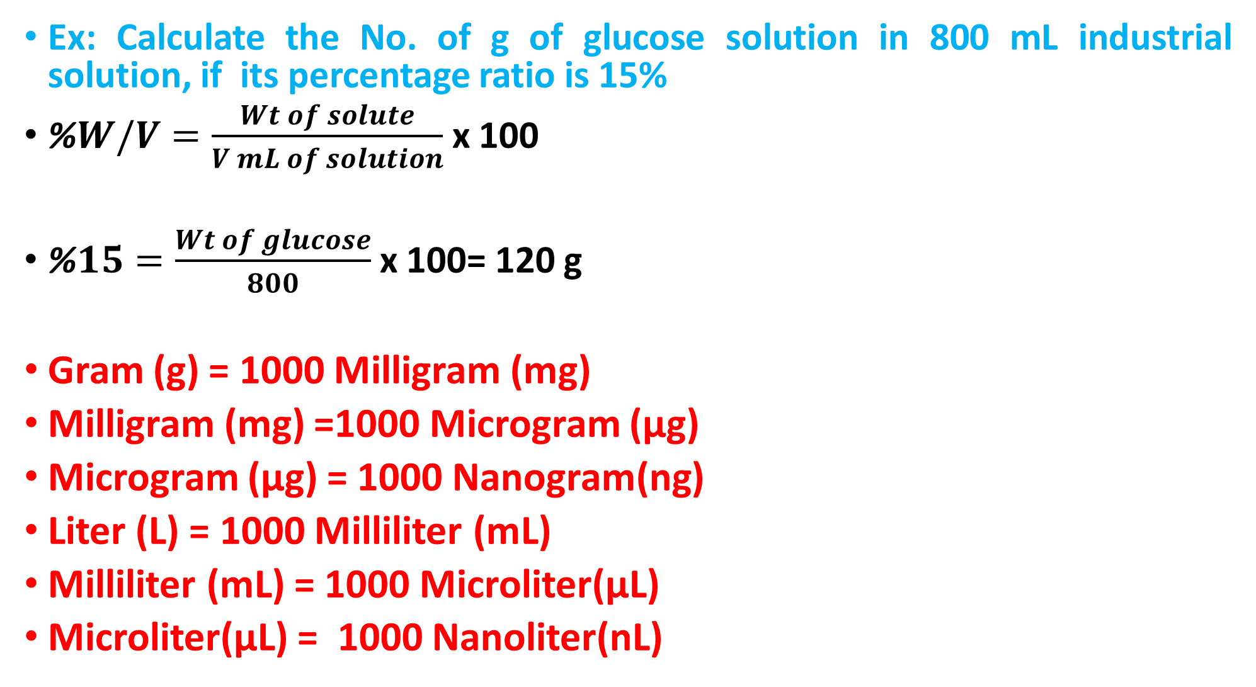
Ex: Calculate the No. of g of glucose solution in 800 mL industrial solution, if its percentage ratio is 15%
%$W/V=\frac{Wt of solute}{V mL of solution}$ x 100
%$15=\frac{Wt of glucose}{800}$ x 100= 120 g
Gram (g) = 1000 Milligram (mg)
Milligram (mg) =1000 Microgram (μg)
Microgram (μg) = 1000 Nanogram(ng)
Liter (L) = 1000 Milliliter (mL)
Milliliter (mL) = 1000 Microliter(μL)
Microliter(μL) = 1000 Nanoliter(nL)

Slide 13
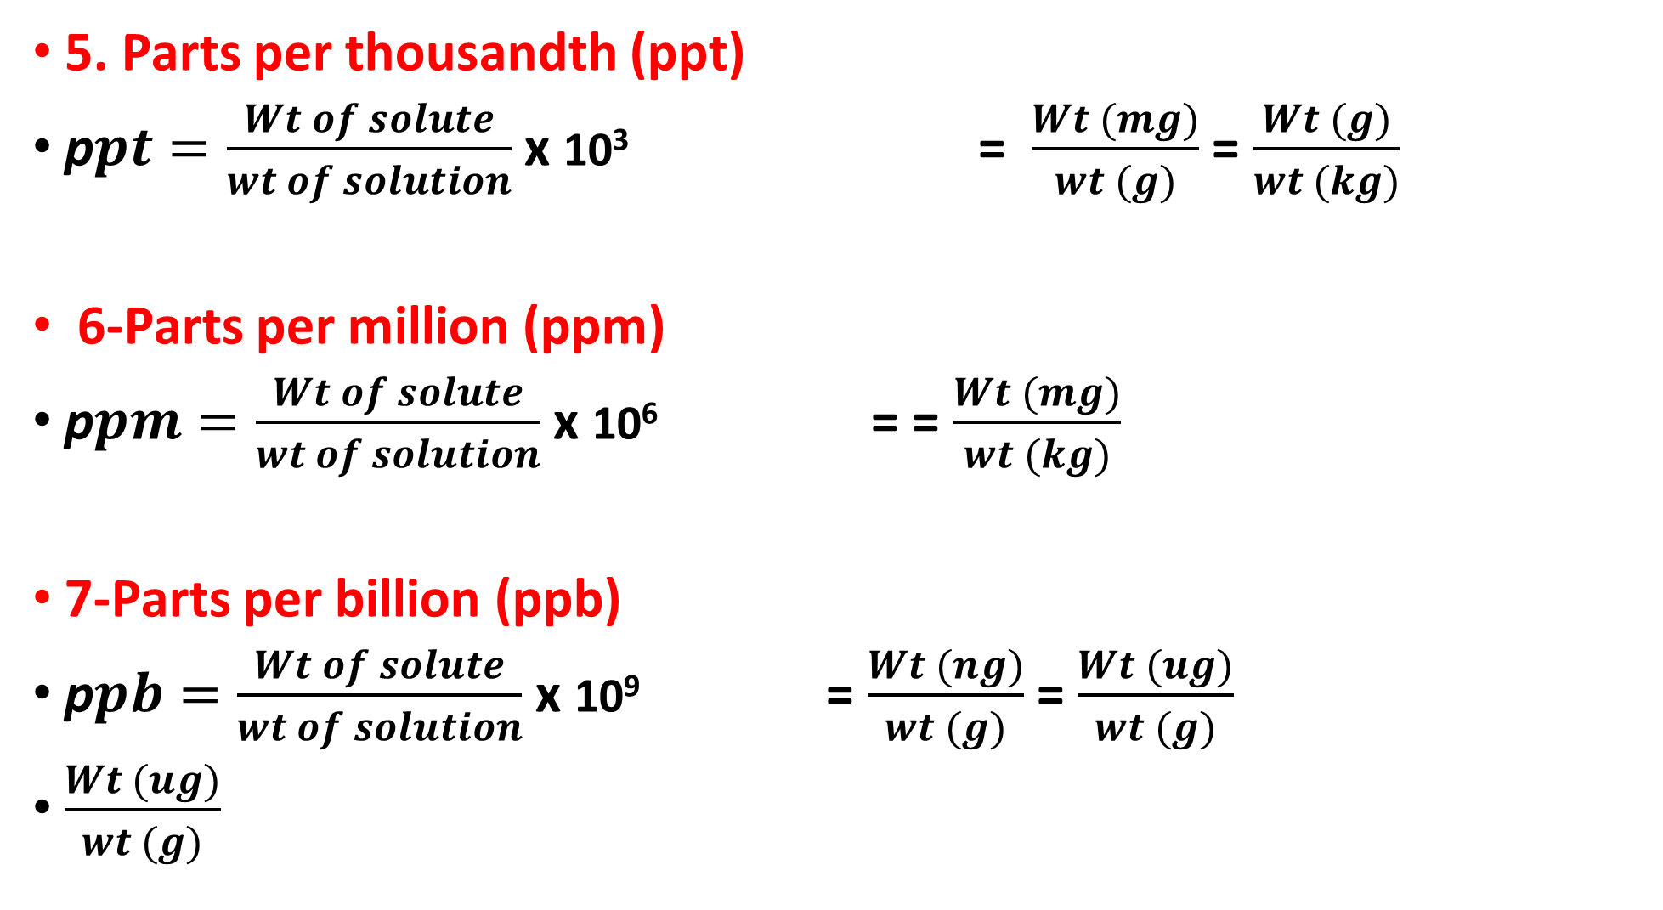
5. Parts per thousandth (ppt)
p$pt=\frac{Wt of solute}{wt of solution}$ x 10³ = $\frac{Wt (mg)}{wt (g)}$ = $\frac{Wt (g)}{wt (kg)}$
6-Parts per million (ppm)
p$pm=\frac{Wt of solute}{wt of solution}$ x 10⁶ = = $\frac{Wt (mg)}{wt (kg)}$
7-Parts per billion (ppb)
p$pb=\frac{Wt of solute}{wt of solution}$ x 10⁹ = $\frac{Wt (ng)}{wt (g)}$ = $\frac{Wt (ug)}{wt (g)}$
$\frac{Wt (ug)}{wt (g)}$

Slide 14
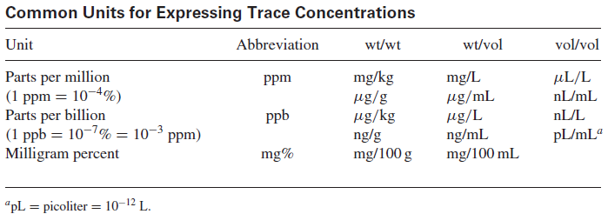

Slide 15
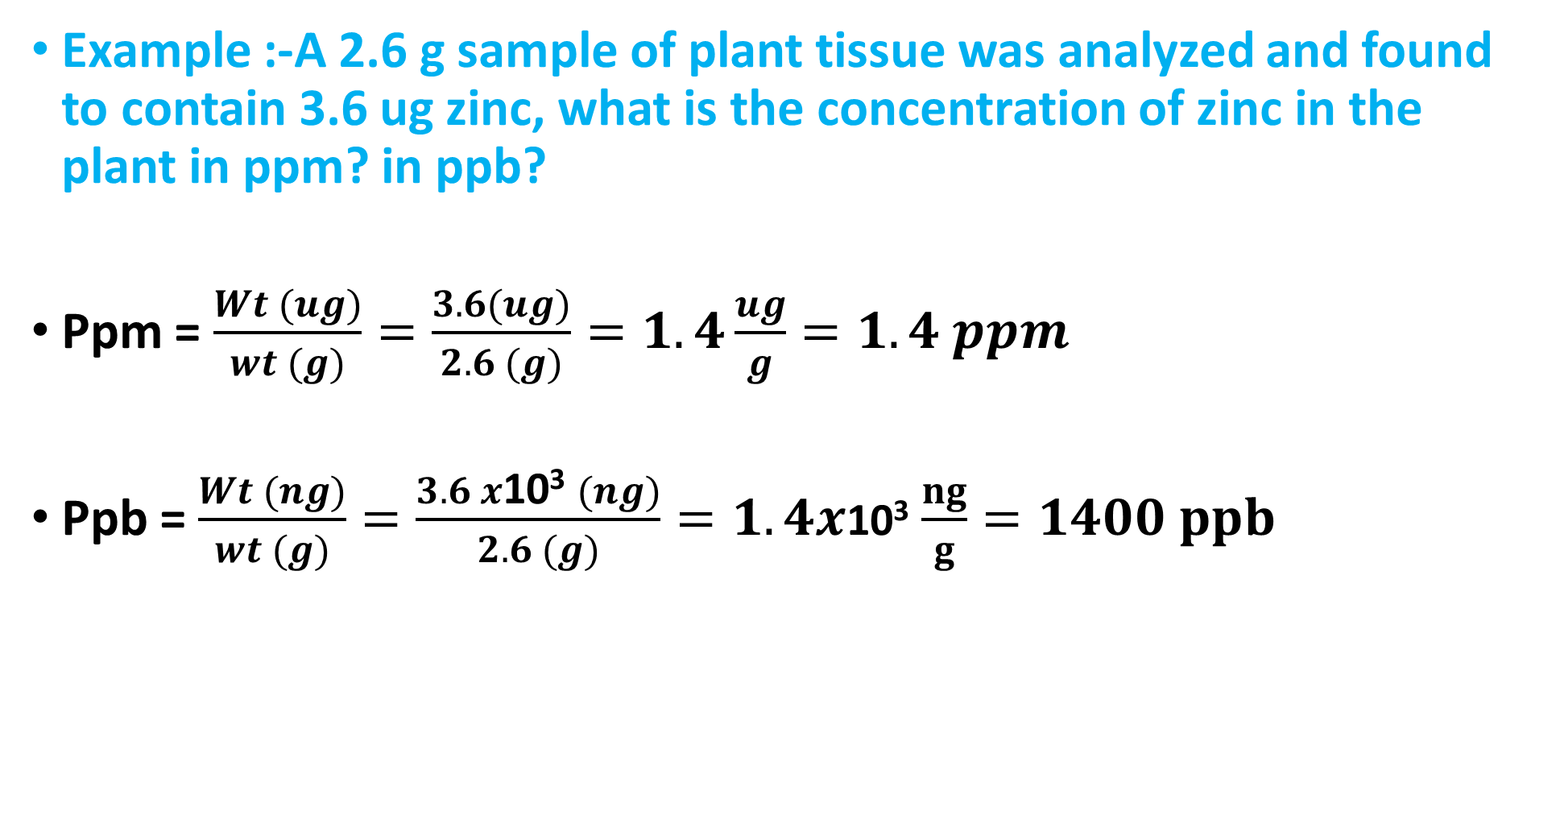
Example :-A 2.6 g sample of plant tissue was analyzed and found to contain 3.6 ug zinc, what is the concentration of zinc in the plant in ppm? in ppb?
Ppm = $\frac{Wt (ug)}{wt (g)}=\frac{3.6(ug)}{2.6 (g)}=1.4\frac{ug}{g}=1.4 ppm$
Ppb = $\frac{Wt (ng)}{wt (g)}=\frac{3.6 x\text{10}\text{3} (ng)}{2.6 (g)}=1.4x\text{10}\text{3}$ $\frac{ng}{g}=1400 ppb$

Slide 16
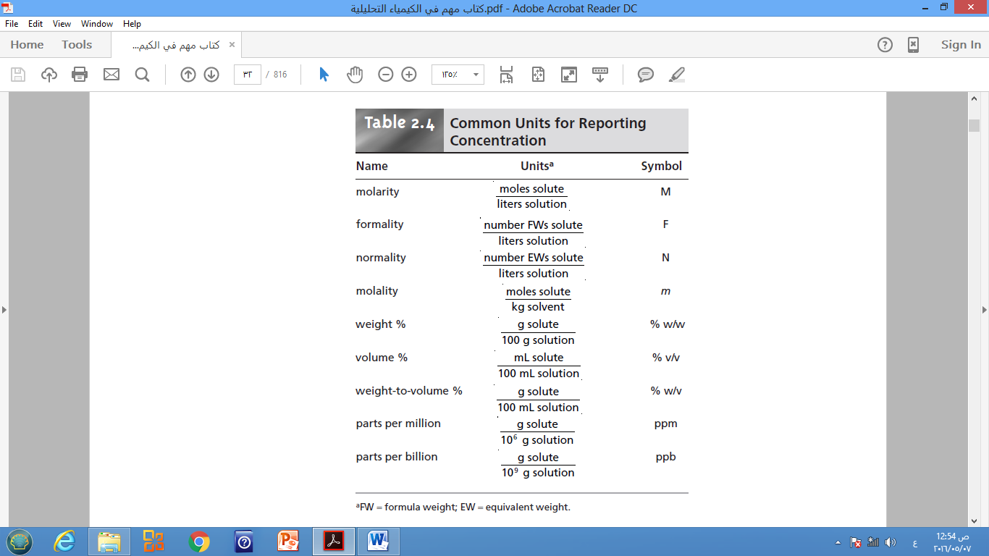

Slide 18
Dilution
• Dilute solutions can be prepared from concentrated solutions. A volume of the concentrated solution is transferred to a fresh vessel and diluted to the desired final volume. The number of moles of reagent in V liters containing M moles per liter is the product M.V = mol/L. L, so we equate the number of moles in the concentrated (conc) and dilute (dil) solutions:
•Dilution Law:
(Mconc x V conc ) = (Mdil x Vdil)
(N conc x V conc ) = (Ndil x Vdil)
We often must prepare to dilute solutions from more concentrated stock solutions. For example, we may prepare a dilute HCL solution from concentrated HCL to be used for titration. Or, we may have a stock standard solution from which we wish to prepare a series of more dilute standards. The millimoles of stock solution taken for dilution will be identical to the millimoles in the final diluted solution.

Slide 19
Ex: Calculate the normality (N) of solution result from dilution 100mL of 0.25 N Nitric Acid to 250mL.
N1V1 = N2V2
0.25 x 100 = N2 x 250 ⇒ N2 = 0.1N

Slide 20
Example:- You wish to prepare a calibration curve for the spectrophotometric determination of permanganate. You have a stock 0.100 M solution of KMnO4 and a series of 100 mL volumetric flasks. What volumes of the stock solution will you have to pipet into the flasks to prepare standards of 1.00, 2.00, 5.00, and 10.0x10⁻³ M KMnO4 solutions.
Solution-1: 1.0x10⁻³ M
(𝐌𝟏 × 𝐕𝟏)𝐜𝐨𝐧𝐜. = (𝐌𝟐 × 𝐕𝟐)𝐝𝐢𝐥𝐮.
0.1 (mmol/ mL) x V1 = 1.0 x 10⁻³ (mmol/mL) X 100 mL
𝐕𝟏 = 𝟏. 𝟎 𝐦𝐋 𝐬𝐭𝐨𝐜𝐤 𝐬𝐨𝐥𝐮𝐭𝐢𝐨𝐧 (𝐜𝐨𝐧𝐜. ),Also to prepare 2.0, 5.0, 10.0x10⁻³ M

Slide 21
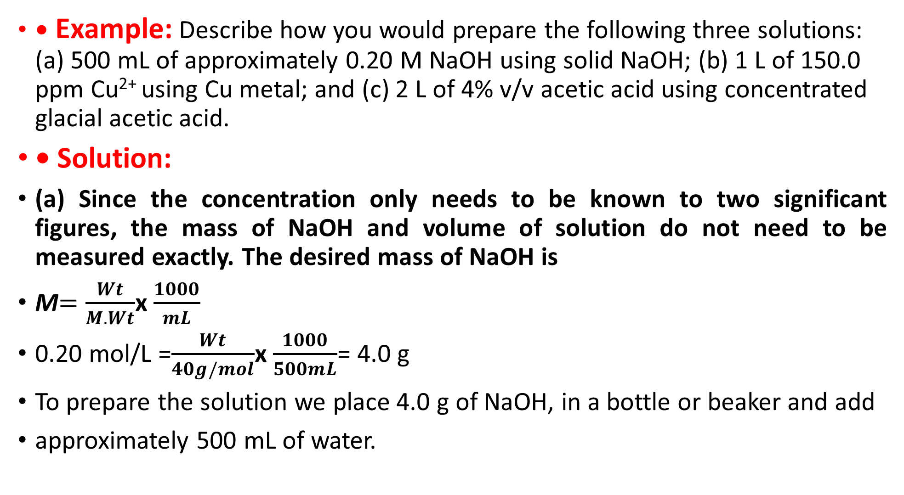
• Example: Describe how you would prepare the following three solutions: (a) 500 mL of approximately 0.20 M NaOH using solid NaOH; (b) 1 L of 150.0 ppm Cu²⁺ using Cu metal; and (c) 2 L of 4% v/v acetic acid using concentrated glacial acetic acid.
• Solution:
(a) Since the concentration only needs to be known to two significant figures, the mass of NaOH and volume of solution do not need to be measured exactly. The desired mass of NaOH is
M$=\frac{Wt}{M. Wt}$x $\frac{1000}{mL}$
0.20 mol/L =$\frac{Wt}{40g/mol}$x $\frac{1000}{500mL}$= 4.0 g
To prepare the solution we place 4.0 g of NaOH, in a bottle or beaker and add
approximately 500 mL of water.

Slide 22
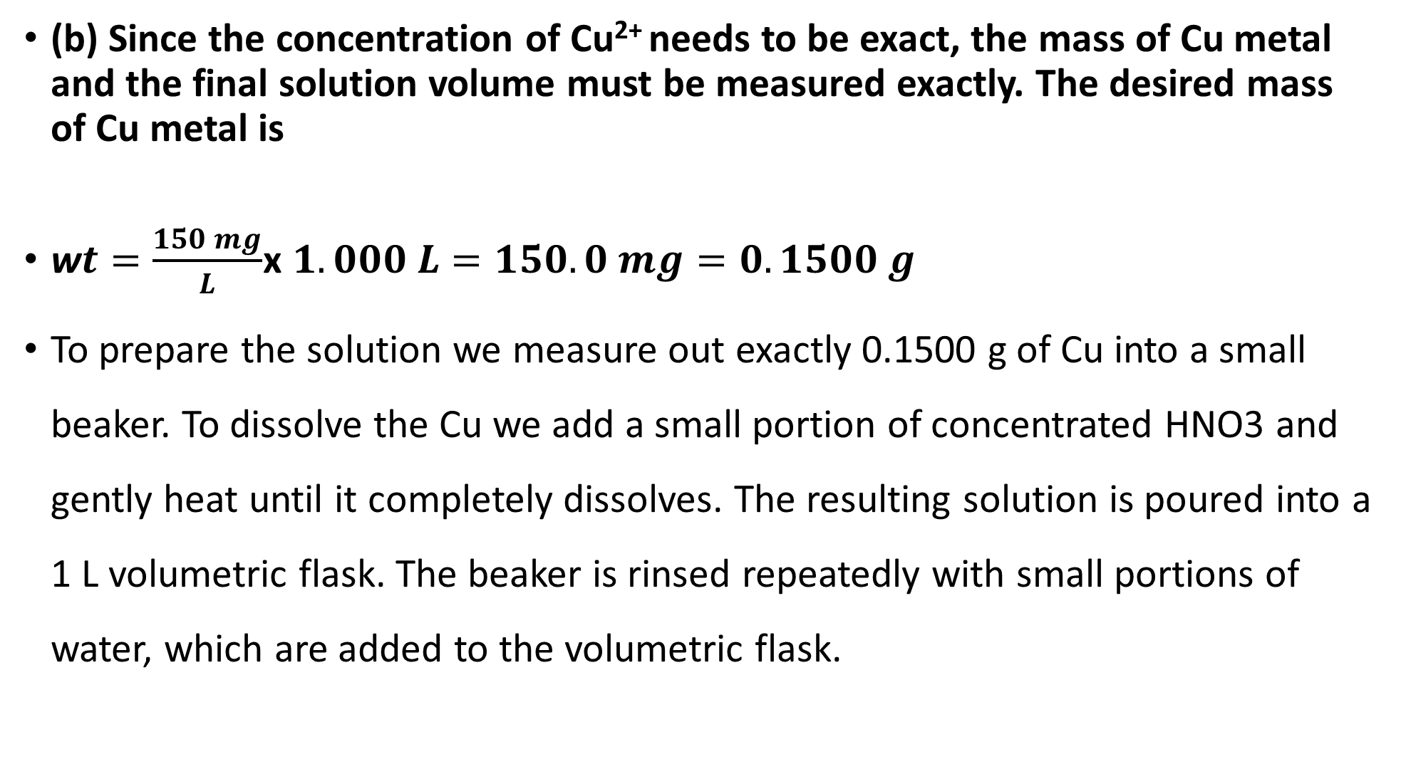
(b) Since the concentration of Cu²⁺ needs to be exact, the mass of Cu metal and the final solution volume must be measured exactly. The desired mass of Cu metal is
w$t=\frac{150 mg}{L}$x $1.000 L=150.0 mg=0.1500 g$
To prepare the solution we measure out exactly 0.1500 g of Cu into a small beaker. To dissolve the Cu we add a small portion of concentrated HNO3 and gently heat until it completely dissolves. The resulting solution is poured into a 1 L volumetric flask. The beaker is rinsed repeatedly with small portions of water, which are added to the volumetric flask.

Slide 23
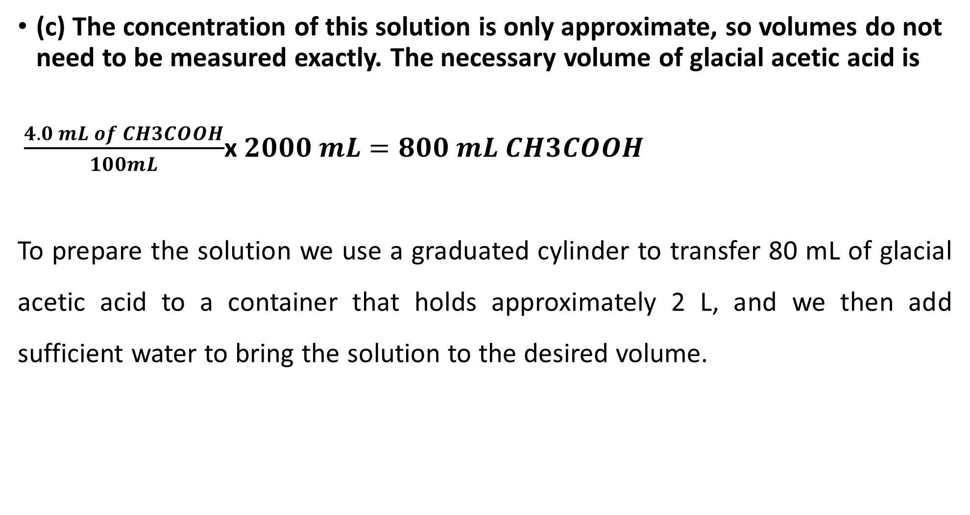
(c) The concentration of this solution is only approximate, so volumes do not need to be measured exactly. The necessary volume of glacial acetic acid is
$\frac{4.0 mL of CH3COOH}{100mL}$x $2000 mL=800 mL CH3COOH$
To prepare the solution we use a graduated cylinder to transfer 80 mL of glacial acetic acid to a container that holds approximately 2 L, and we then add sufficient water to bring the solution to the desired volume.

Slide 24
Stock solution: A solution of known concentration from which other solutions are prepared. Quantitative transfer: The process of moving a sample from one container to another in a manner that ensures all material is transferred.
• Example: The molarity of “concentrated” HCl is approximately 12.1 M. How many milliliters of this reagent should be diluted to 1.000 L to make 0.100 M HCl?
• Solution: The dilution formula handles this problem directly:
M conc. Vconc = M˛dil . Vdil
(12.1 M).(x mL) = (0.100 M).(1 000 mL) → x = 8.26 mL
To make 0.100 M HCl, we would dilute 8.26 mL of concentrated HCl up to 1.000 L. The concentration will not be exactly 0.100 M, because the reagent is not exactly 12.1 M. A table inside the cover of this book gives volumes of common reagents required to make 1.0 M solutions.

