Slide 1
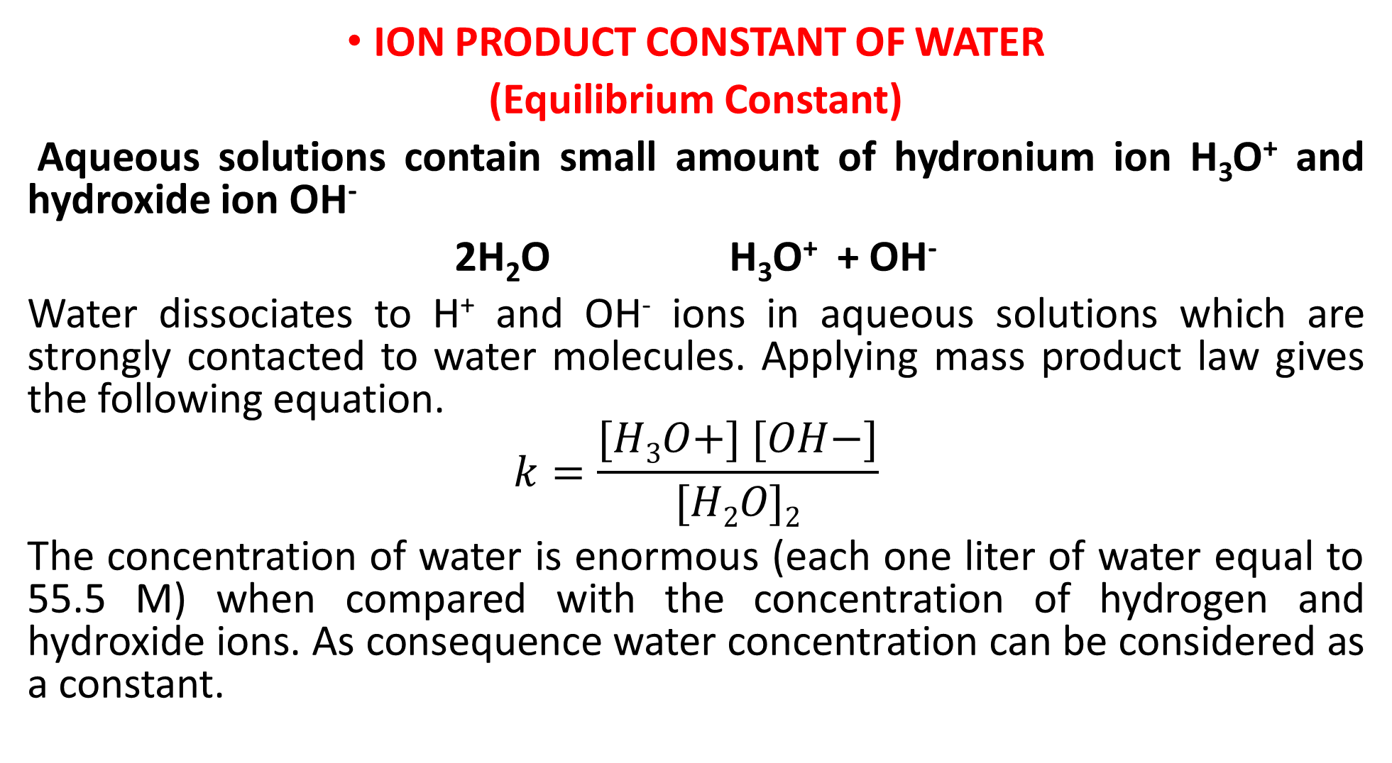
ION PRODUCT CONSTANT OF WATER
(Equilibrium Constant)
Aqueous solutions contain small amount of hydronium ion H₃O⁺ and hydroxide ion OH⁻
2H₂O H₃O⁺ + OH⁻
Water dissociates to H⁺ and OH⁻ ions in aqueous solutions which are strongly contacted to water molecules. Applying mass product law gives the following equation.
$$k=\frac{[H3O+] [OH−]}{[H2O]2}$$
The concentration of water is enormous (each one liter of water equal to 55.5 M) when compared with the concentration of hydrogen and hydroxide ions. As consequence water concentration can be considered as a constant.

Slide 2
Kw = [H₃O+] [OH-] or Kw =[H⁺][OH⁻]
H₂O H⁺ + OH⁻
Kw = [H⁺] . [OH⁻]
Kw = 1.0 x 10⁻¹⁴ mole/L
[H+] . [OH-] = K [H₂O] = Kw (ion product constant of water) by using water concentration as one, Kw approximation value is:
1.01x10⁻¹⁴ or 1.0x10⁻¹⁴ at 25 ºC. Kw increasing with the increase in temperature (at 50 ºC = 5.47 x 10⁻¹⁴ and at 100 ºC = 49x10⁻¹⁴).

Slide 3
Kw = ion product constant of water = [H⁺][OH-] = 1.0x10⁻¹⁴
in case of pure water.
[H⁺] = [OH⁻]
[H⁺] = [OH⁻] = 10⁻⁷ mole/L = M
By taking the logarithm of this equation
Kw= [H+] [OH-]
-log Kw= -log [H⁺] [OH⁻]
-log Kw= -log [H⁺] –log [OH⁻]
pKw = pH + pOH = 14
if pH < 7 then the solution acidic.
if pH > 7 then the solution is basic.
If pH = 7 then the solution is equilibrium.

Slide 5
Ex2: Calculate the pH and pOH values of a solution in which the hydronium ion concentration is 2.0 x 10⁻³ M.
[H⁺] = [H₃O⁺] = 2.0 x 10⁻³ mole/L
pH = -log [H] = -log [2.0 x 10⁻³]
= 2.699
pOH= 14- pH = 14 – 2.699 = 11.301

Slide 6
EQUILIBRIUM CONSTANTS FOR PAIR ACIDS AND BASES
Calculation of hydronium and hydroxide ions for strong, acids and bases and weak acids and bases.
1-Strong acids
The strong Acids will completely ionize in its aqueous solution, and shown by one arrow.
HCl H⁺ + Cl⁻ [H⁺] = [HCl]
Ex. Calculate [H+] and pH of 0.01 M HCl solution
HCl H+ + Cl-
before ionization 0.01 0 0
after ionization 0 0.01 0.01
[H+] = 0.01 M
pH = -log [H⁺] = -log 0.01 = 2

Slide 7
Ex: Calculate pH and pOH for 0.15 M H₂SO₄
H₂SO₄ 2H⁺ + SO⁴⁻
before ionization 0.015 0 0
after ionization 0 2 x 0.15 0.15
[H⁺] = 2 x 0.15 = 0.3 M
pH = -log [H⁺] = -log 0.3 = 0.523
Kw = PH + pOH =14
pOH = 14 — 0.523 = 13.477

Slide 8
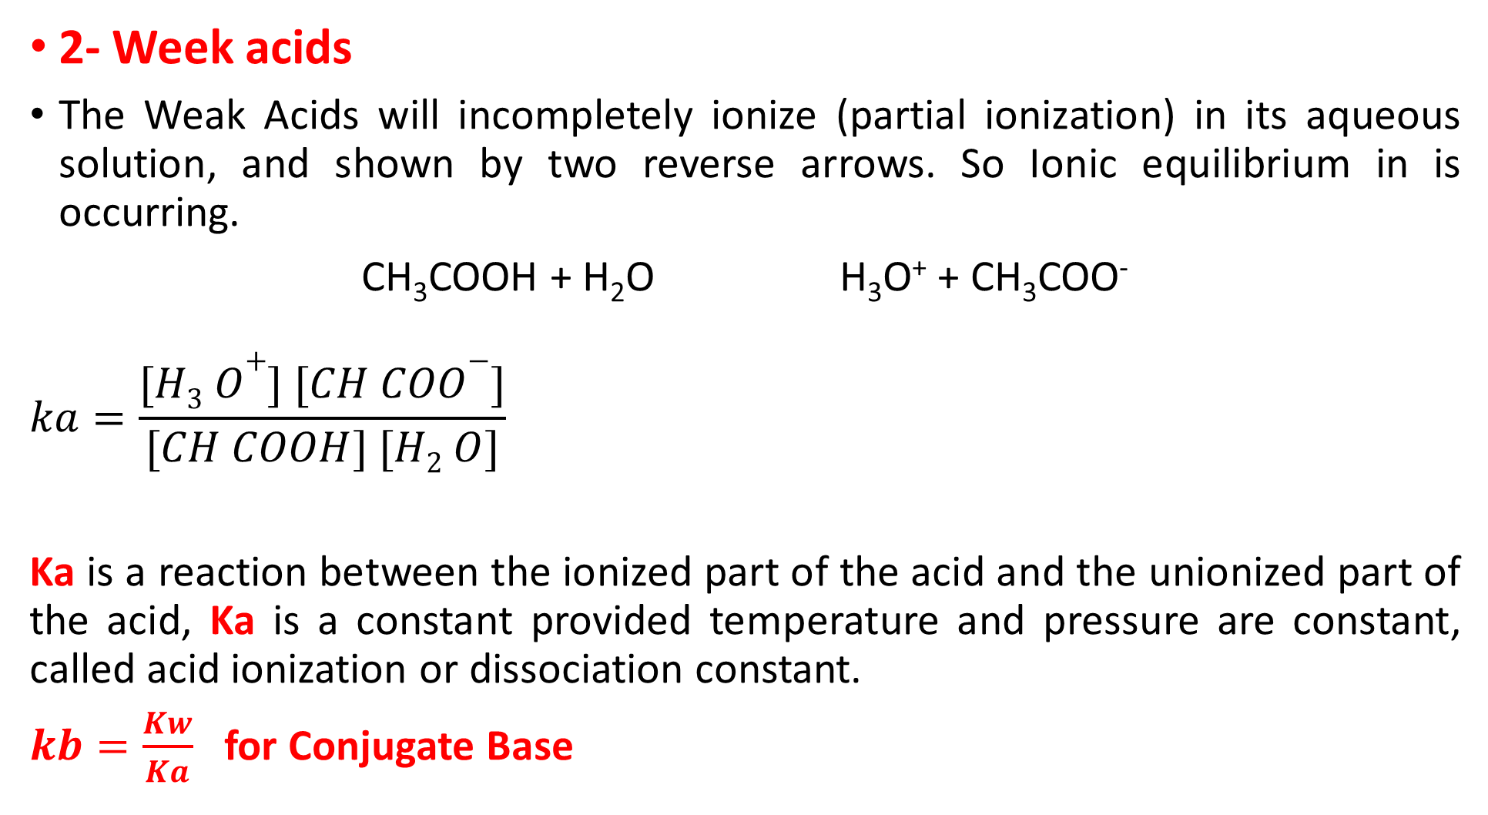
2- Week acids
The Weak Acids will incompletely ionize (partial ionization) in its aqueous solution, and shown by two reverse arrows. So Ionic equilibrium in is occurring.
CH₃COOH + H₂O H₃O⁺ + CH₃COO⁻
$$ka=\frac{[H3 O+] [CH COO−]}{[CH COOH] [H2 O]}$$
Ka is a reaction between the ionized part of the acid and the unionized part of the acid, Ka is a constant provided temperature and pressure are constant, called acid ionization or dissociation constant.
$kb=\frac{Kw}{Ka}$ for Conjugate Base

Slide 9
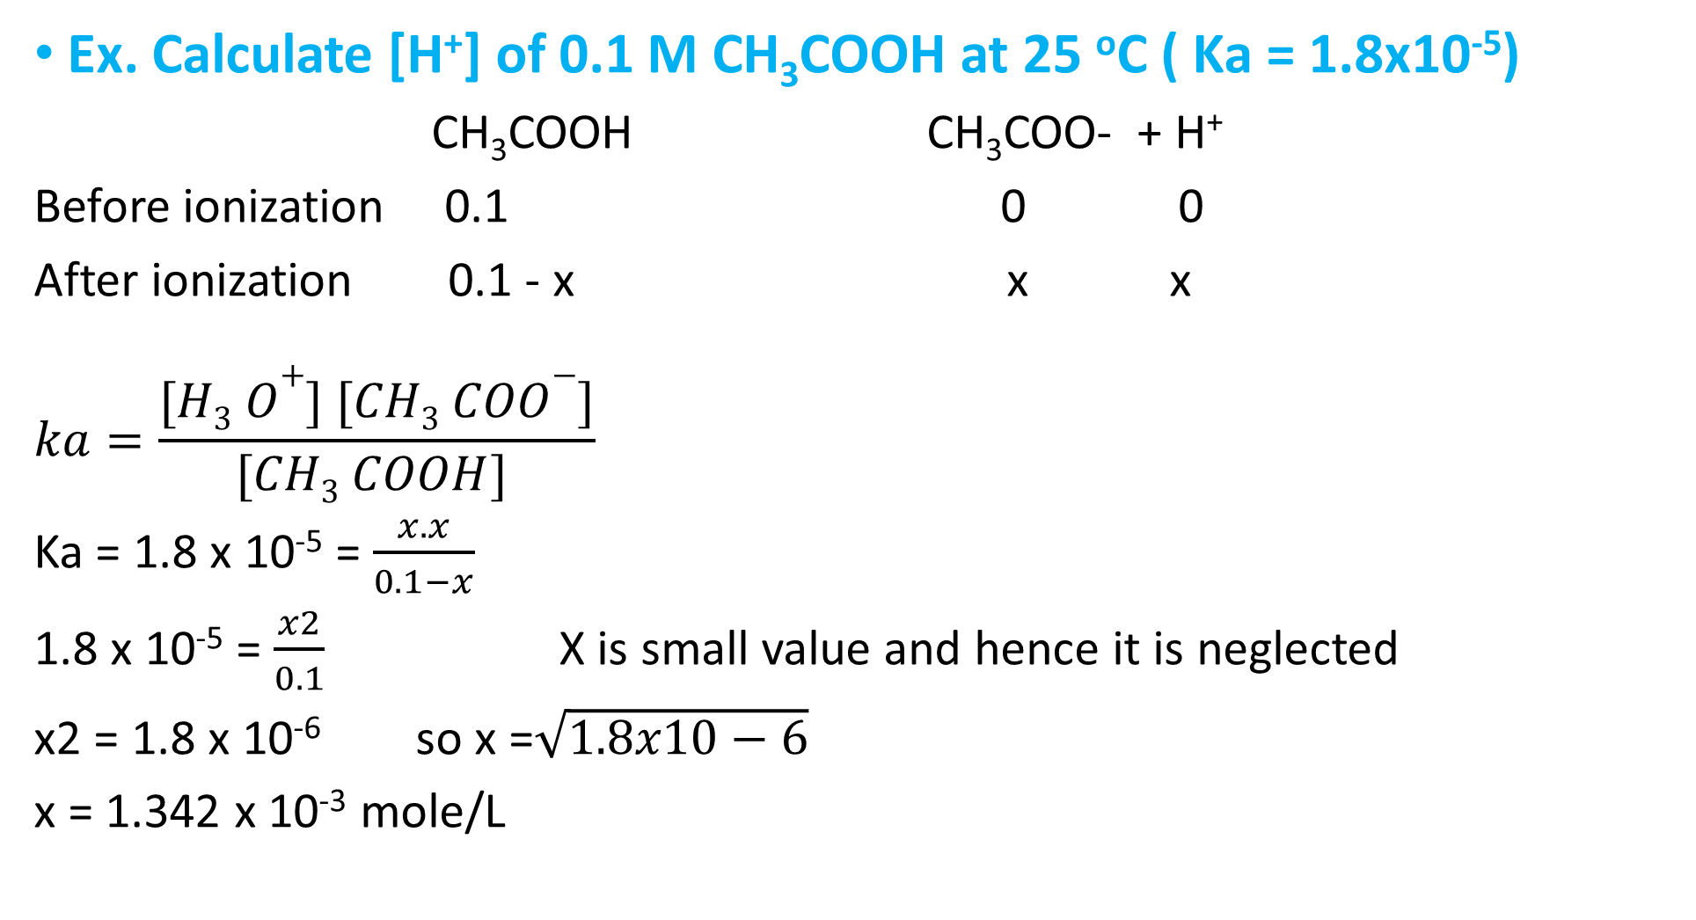
Ex. Calculate [H⁺] of 0.1 M CH₃COOH at 25 ºC ( Ka = 1.8x10⁻⁵)
CH₃COOH CH₃COO- + H⁺
Before ionization 0.1 0 0
After ionization 0.1 - x x x
$$ka=\frac{[H3 O+] [CH3 COO−]}{[CH3 COOH] }$$
Ka = 1.8 x 10⁻⁵ = $\frac{x. x}{0.1−x}$
1.8 x 10⁻⁵ = $\frac{x2}{0.1}$ X is small value and hence it is neglected
x2 = 1.8 x 10⁻⁶ so x =$\sqrt{1.8x10−6}$
x = 1.342 x 10⁻³ mole/L

Slide 10
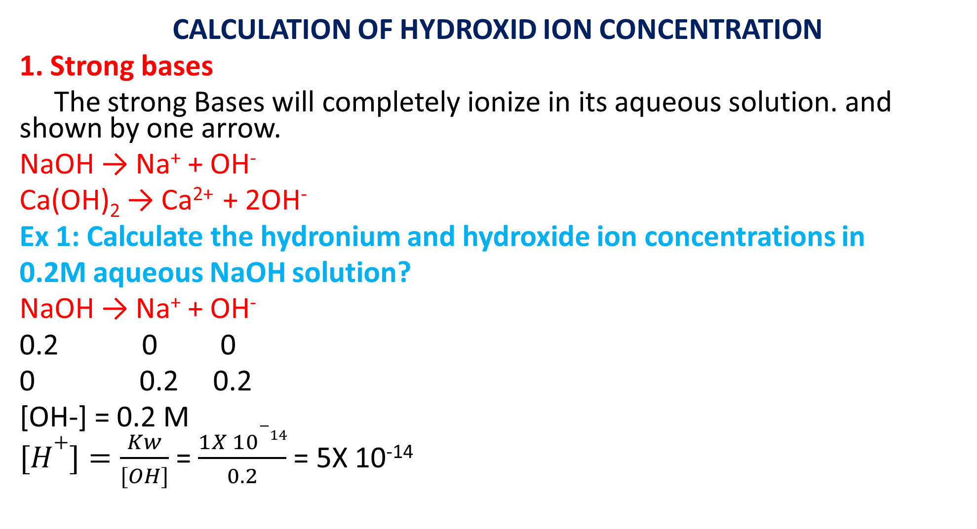
CALCULATION OF HYDROXID ION CONCENTRATION
1. Strong bases
The strong Bases will completely ionize in its aqueous solution. and shown by one arrow.
NaOH → Na⁺ + OH⁻
Ca(OH)₂ → Ca²⁺ + 2OH⁻
Ex 1: Calculate the hydronium and hydroxide ion concentrations in
0.2M aqueous NaOH solution?
NaOH → Na⁺ + OH⁻
0.2 0 0
0 0.2 0.2
[OH-] = 0.2 M
$[H+]=\frac{Kw}{[OH]}$ = $\frac{1X 10−14}{0.2}$ = 5X 10⁻¹⁴

Slide 11
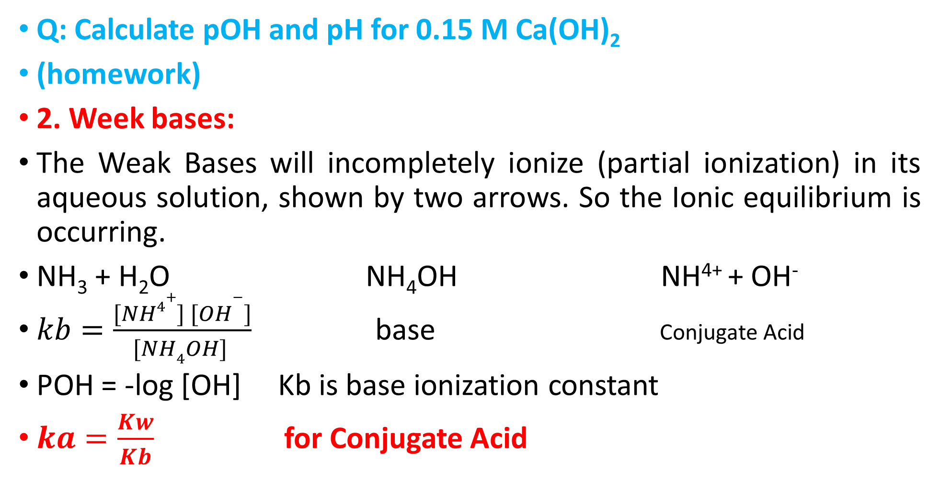
Q: Calculate pOH and pH for 0.15 M Ca(OH)₂
(homework)
2. Week bases:
The Weak Bases will incompletely ionize (partial ionization) in its aqueous solution, shown by two arrows. So the Ionic equilibrium is occurring.
NH₃ + H₂O NH₄OH NH⁴⁺ + OH⁻
$kb=\frac{[NH4+] [OH−]}{[NH4OH] }$ base Conjugate Acid
POH = -log [OH] Kb is base ionization constant
$ka=\frac{Kw}{Kb}$ for Conjugate Acid

Slide 12
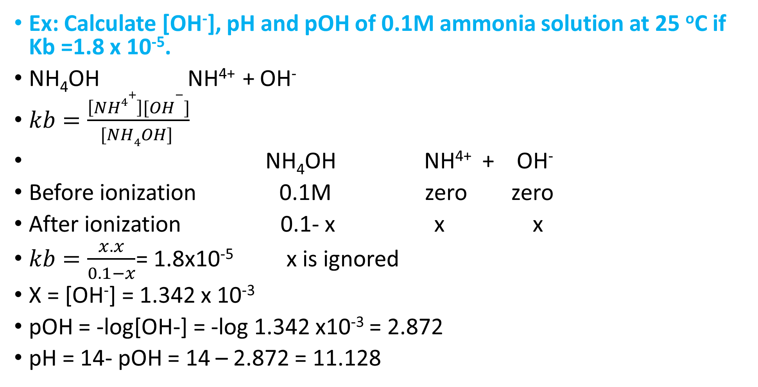
Ex: Calculate [OH⁻], pH and pOH of 0.1M ammonia solution at 25 ºC if Kb =1.8 x 10⁻⁵.
NH₄OH NH⁴⁺ + OH⁻
$kb=\frac{\left[NH4+\right][OH−]}{[NH4OH] }$
NH₄OH NH⁴⁺ + OH⁻
Before ionization 0.1M zero zero
After ionization 0.1- x x x
$kb=\frac{x. x}{0.1−x}$= 1.8x10⁻⁵ x is ignored
X = [OH⁻] = 1.342 x 10⁻³
pOH = -log[OH-] = -log 1.342 x10⁻³ = 2.872
pH = 14- pOH = 14 – 2.872 = 11.128

Slide 13
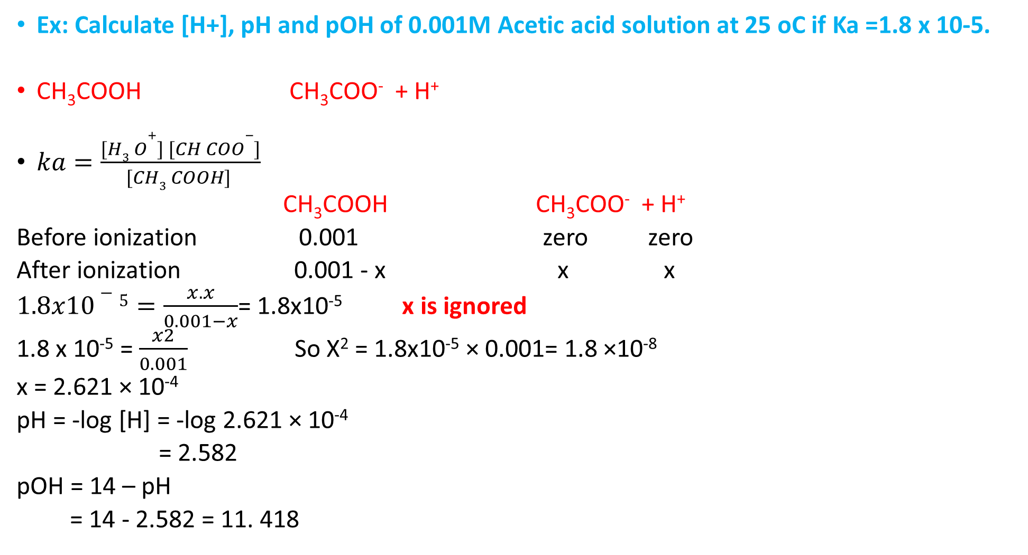
Ex: Calculate [H+], pH and pOH of 0.001M Acetic acid solution at 25 oC if Ka =1.8 x 10-5.
CH₃COOH CH₃COO⁻ + H⁺
$ka=\frac{[H3 O+] [CH COO−]}{[CH3 COOH] }$
CH₃COOH CH₃COO⁻ + H⁺
Before ionization 0.001 zero zero
After ionization 0.001 - x x x
$1.8x10−5=\frac{x. x}{0.001−x}$= 1.8x10⁻⁵ x is ignored
1.8 x 10⁻⁵ = $\frac{x2}{0.001}$ So X² = 1.8x10⁻⁵ × 0.001= 1.8 ×10⁻⁸
x = 2.621 × 10⁻⁴
pH = -log [H] = -log 2.621 × 10⁻⁴
= 2.582
pOH = 14 – pH
= 14 - 2.582 = 11. 418

