Slide 1
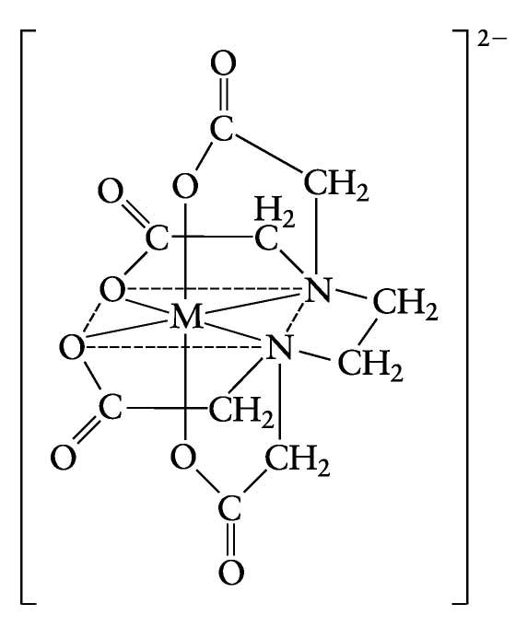
Reagent EDTA
• Disodium salt of EDTA is a water-soluble chelating agent and is always preferred. It is non-hygroscopic and a very stable sequestering agent.
• EDTA has the broadest general application because:
1. It has a low price
2. The unique structure, which has six ligands atoms
3. It forms strainless five-membered rings

Slide 2
The selectivity of EDTA can be increased by the following procedures: Masking and demasking agent
• Masking agents: Protects some components of the analyte from reacting with EDTA. These reagents form complexes with interfering ions which are more stable than complexes formed with EDTA.
Masking agents: A reagent added to prevent reaction of some metal ion with EDTA (block metal ions)
• Examples of masking agent: (give examples of masking agent)
KCN: It is used as masking agent for Ag+ , Cu²⁺ , Cd²⁺ , Co²⁺ , Ni²⁺ , Zn²⁺ , … etc.
M⁺ + 2CN⁻ [M(CN)₂]⁻
M⁺ + 4CN⁻ [M(CN)4]²⁻
Triethanolamine: It is used as masking agent for Fe³⁺ , Al³⁺ and Sn2+
Fluoride (e.g. NH₄F): It is used as masking agent for Fe³⁺ and Al³⁺ to give [FeF₆]³⁻ and [AlF₆]³⁻
Iodide (KI): It is used as masking agent for Hg²⁺ to give tetraiodo complex (HgI₄)

Slide 3
• Demasking agent: Releasing masking agent from the analyte.
Reagents that release of a metal ion from a masking agent
Example:
• Example of using masking and demasking agents in complexometry is the analysis of 3 metals, Cu, Cd, and Ca. The following method of analysis is followed
Step 1: All metals are titrated
Ca Ca-EDTA
Cd + EDTA Cd-EDTA
Cu Cu-EDTA
How can we determine a mixture of metals using complexometric titration?
Step 2: Only Ca titrated
[Cu, Cd] + cyanide ion [Cu-cyanide]complex〕 EDTA
[Cd-cyanide]complex〕 EDTA

Slide 4
Ca + cyanide ion no reaction EDTA Ca-EDTA
• Step 3: Cd and Ca are titrated
[Cd-cyanide]complex + HCHO Cd²⁺ (free)
demasking agent
[Cu-cyanide]complex + HCHO no reaction
Cd Cd-EDTA
+ EDTA
Cu Cu-EDTA
Oxidation with H₂O₂ releases Cu²⁺ from [Cu⁺ -Thiourea] complex.

Slide 5
Titration curves
For derivation of the titration curve,
consider the titration of 50.0 mL of 0.1 M solution of Mg²⁺ (buffered at pH 10) with 0.1 M EDTA solution.
We calculate the concentration of Mg²⁺ (as pMg= -log(Mg) and plotted versus the volume added from ETDA
pMg before the addition of EDTA
Mg²⁺ = 0.1 M , so, pMg=-log (0.1)=1.0
At start of Titration when no titrant EDTA is added to the solution, only Mg²⁺ , will be present in the solution. The concentration of Mg²⁺ can be given as,

Slide 6
2) pMg after adding 10.0 mL EDTA, we will calculate the remaining unchelated Mg solution in the whole solution (60 ml)
Mg⁺² + y⁻⁴ Mgy⁻²
$50×0.1$ $10×0.1$ 0
5 1 0
4 0 4
$MMg+2 unreacted=\frac{\left(50×0.1\right)− (10×0.1)}{50+10}$ = 0.067 M
P_{Mg} = -log(0.067) =1.17
3) pMg after adding 25.0 mL EDTA, we will calculate the remaining unchelated Mg solution in the whole solution (75 ml)
$MMg+2 unreacted=\frac{(50×0.1) (25×0.1)}{50+25}$ = 0.033 M
P_{Mg} = -log(0.033) =1.48

Slide 7
4) pMg at the equivalence point
At this Point, 50 mL of EDTA have been added to completely react with Mg solution
We will use the stability constant to calculate the pMg
Mg⁺² + y ⁻⁴ ↔ MgY ⁻²
$50×0.1$ $50×0.1$ 0
5 5 0
0 0 5-a
K_{stab} = $\frac{(MgY−2)}{(\text{Mg}\text{2}\text{+})(\text{Y} \text{−}\text{4})}=5×108$
Concentration of MgY²⁻ is calculated as follows
$MMg+2=\frac{50×0.1}{50+50}\text{ = }\text{0.05 }\text{M}$
M _{MgY} ⁻² $=\frac{50×0.1}{50+50}\text{ = }\text{0.}\text{05 }—\text{a}$

Slide 8
Substitute at equation K_{stab} = $\frac{\text{(}\text{0.05 }—\text{a} ) }{a2}\text{ =} 5×108$
a, is neglected because it is very small relative to 0.05
So, $\frac{\text{(}\text{0.05 }—\text{a} ) }{a2}$ a=(Mg⁺² ) =1.0×10^{—5} , P_{Mg} = 5.0
5) pMg, beyond the equivalence point:
By adding 60 mL of the 0.1 M EDTA
M _{MgY -2} $=\frac{50∗0.1}{50+60} —\text{a}$
Neglect the term a
and then substitute (MgY²⁻) of 5/110 M in K_{stab} equation

Slide 9
There will be an excess from EDTA
Y^{—4} = $\frac{(60 × 0.1) (50× 0.1)}{50+60}\text{ =}\text{1}\text{/}\text{110}$
$\frac{\text{5}\text{/}\text{110 }}{(\text{1}\text{/}\text{110}\text{)} ×(a)}=5.0×108$
a =1x10⁸ M And pMg=8.0
The titration curve is plotted by using the previous data
Volume added (ml )EDTA pMg

