Slide 1
Oxidation-Reduction/ Redox Reactions
(electron transfer reactions)
Example: formation of MgO from Mg and O₂
Oxidation reaction:
Reduction reaction:
half-reaction involves lose e⁻
half-reaction involves gain e⁻
2Mg 2Mg²⁺ + 4e⁻
O₂ + 4e⁻ 2O²⁻
Half reaction: Reaction that shows e⁻ involved in redox reaction
2Mg + O₂ + 4e⁻ 2Mg²⁺ + 2O²⁻ + 4e⁻
2Mg + O₂ 2MgO
Oxidized
Reduced
Reducing Agent: donates electrons to O₂ and causes O₂ to be reduced
Oxidizing Agent: accepts electrons from Mg and causes Mg to be oxidized

Slide 2
The electrical potential is a measure of the relative energy of an electron on a molecule/atom.

Slide 3
When ΔG⁰ < 0, energy is released and reactions proceed without added energy. When ΔG⁰ > 0, energy is required to make a reaction proceed. It is possible for NO₂ - to oxidize H₂O to O₂, but this would require additional energy. Reduction potential values can be used to calculate ΔG⁰ according to the Nernst Equation:
n = number of e- transferred
F = Faraday constant (23 kcal V⁻¹ mol⁻¹)
ΔE⁰ = E⁰ (oxidizing agent) - E⁰ (reducing agent)= Eº (reduction) – Eº (oxidation)
ΔE⁰ and ΔG⁰ have opposite signs, so when ΔE⁰ > 0, then ΔG⁰ will be negative
Since a redox reaction is spontaneous, the amount of energy released must be greater than the amount of energy absorbed. Thus, all redox reactions are exothermic in nature.
A spontaneous redox reaction is characterized by a negative value of ΔG°, which corresponds to a positive value of E°_{cell}.

Slide 4
Equilibrium Constant and Free Energy Change for an Electrochemical Cell
Two important parameters that can be determined from a cell potential are the equilibrium constant for the cell reaction and the free energy change for the cell reaction.
1- Determining the Equilibrium Constant from Eº_{cell}
2- Determining the Standard State Free Energy Change from Eº_{cell}
3- Determining the Non-Standard Free Energy Change
To calculate the equilibrium constant for an electrochemical cell we need to know:
the standard state potential for a cell
the half-reactions involved
The Nernst equation is used in calculating the equilibrium constant.

Slide 5
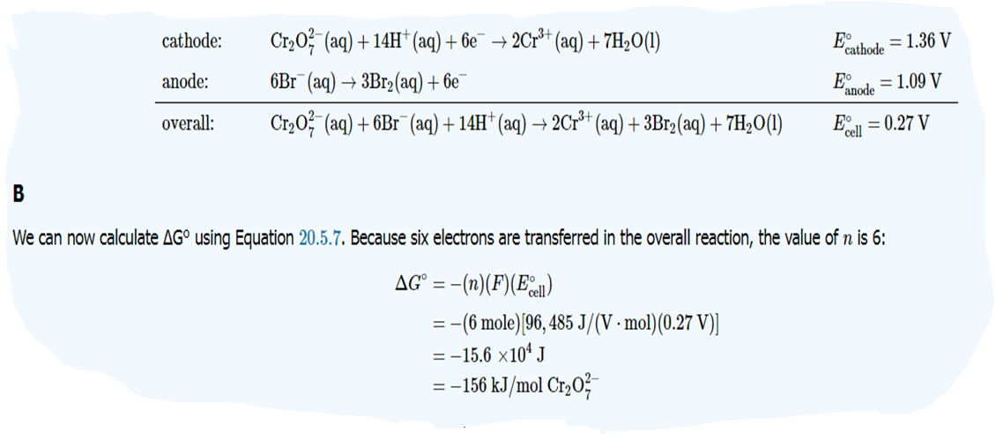

Slide 6
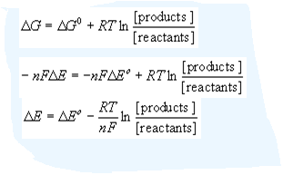
The free energy change of any reaction is given by the following
When Ecell = + the reaction proceeds spontaneously to the right. As the reaction proceeds the E+cell becomes smaller and smaller until eventually it reaches zero. An Ecell =0 means that there is no net reaction occurring and that the cell has reached equilibrium. When Ecell = 0 The Q term in the Nernst equal equals to K (Q = K(
E= E^{O} — log K Where K = equilibrium constant
and
Eº$=\frac{0.0592}{n}$ log K

Slide 7
The Nernst equation allows the reduction potential to be calculated at any temperature and concentration of reactants and products; the standard reaction potential must be measured at 298K and with each solution at 1M.
The Nernst equation is:
E⁰_{cell} $=\frac{RT}{nF}\ln{Q }$
E: is the reduction potential for the specified non-standard state
E₀ : is the standard reduction potential
R: and F are the gas and Faraday constants, respectively
N: is the number of electrons transferred in the reaction
If T is held constant at 298K, the Nernst equation can be condensed using the values for the constants R and F:
At equilibrium Q = K. Substituting in K for Q, and the values for R, T, and F, we get:
E⁰_{cell} $=\frac{0.0257}{n}\ln{Q =\text{E}\text{0}\text{cell} =\frac{0.0592}{n}\log{K }}$
$ΔG=ΔG^{0}+ RT$ $\ln{Q }$
— nF E_{cell} = — nF Eº_{cell} $+ RT$ $\ln{Q }$

Slide 8
It can be further simplified if the reaction has reached equilibrium, as in that case Q is the equilibrium constant K:
This equation allows the equilibrium constant to be calculated just from the standard reduction potential and the number of electrons transferred in the reaction
lnK= $\frac{nE0}{0.0257}$
$\log{K=\frac{nE0}{0.0592}}$

