Slide 1
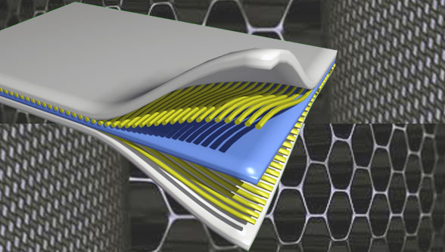
Composite Materials
Dr. Abbas Hasan Faris
Lecture- 7

Slide 2
Rule of Mixtures
The rule of mixtures (ROM) is a weighted method used to predict the properties of composite materials such as a fiber-reinforced polymer (FRP) including the tensile performance based upon the following assumptions:
(1) The fiber is homogeneous, linear elastic, and well-arranged regularly in space.
(2) The matrix is also homogeneous, linear elastic, and isotropic.
(3) There are no voids, the fiber and the matrix are completely coupled.
Based on these assumptions, the tensile performance of FRP composed of fiber and polymer in the matrix can be obtained by combining the volume fraction and the tensile properties of the fiber and the matrix linearly.

Slide 3
• Mechanical properties of composites depend on the volume fraction of reinforcement and matrix.
• The basic properties can be calculated using the rule-of-mixture principle with some assumptions
• The type of reinforcement (fiber, particle or whiskers) and their orientation play a major role in determining the strength of composites
• In composites, if fibers are oriented at an angle of 0, their strength along the fiber direction will be more than in the other directions
• In particle-reinforced composites, the distribution of particles throughout the component is key to providing uniform material property

Slide 4
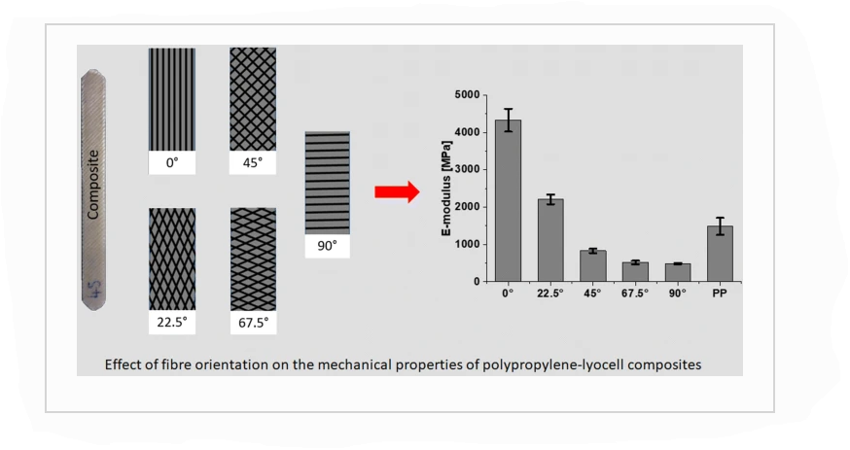
According to the Rule of Mixtures properties of composite materials are estimated as follows:
Density
Coefficient of Thermal Expansion
Modulus of Elasticity
Shear modulus
Poisson's ratio
Tensile strength

Slide 6
While the properties perpendicular to the laminar composite

Slide 7
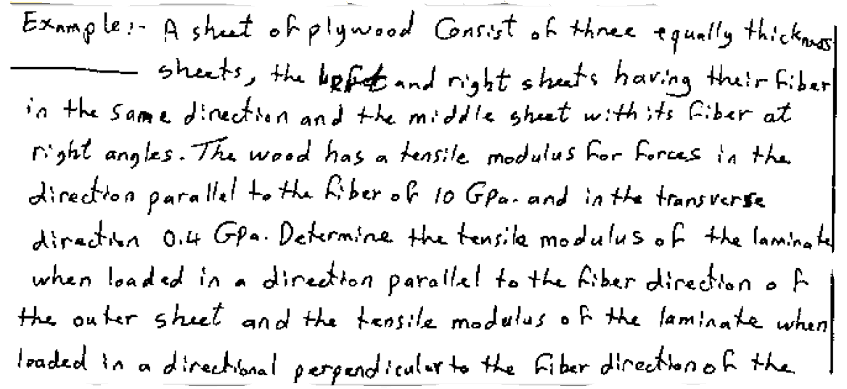

Slide 11
Notations used in rule-of-mixture are as follows:
c, f, and m represent composite, fiber, and matrix respectively, V is Volume fraction, P is load withstand, A is the cross-sectional area, E is Elastic modulus, σ is stress, ε is Strain, μ is a Poisson ratio and ρ is Density.
Volume fraction of fiber, vf = volume of fiber/ volume of composite
Volume of composite, V_{c} = V_{f} + V_{m}
For unit volume of composite, 1 = V_{f} + V_{m}
Volume fraction of matrix, V_{m} = 1 – V_{f}
The Rule of Mixtures is actually composed of two models: Voigt, W. (1889) and Reuss, A. (1929).
The first model is normally applied to calculate elastic modulus in the fiber direction (longitudinal direction), while the second one is used for estimations in the transverse direction.

Slide 12
In general terms “Rule of Mixtures” may be expressed as follows:
𝑿_{𝒄} = 𝑽_{𝒇}𝑿_{𝒇} + 𝑽_{𝒎}𝑿_{𝒎}
𝑿_{𝒄} is the composite property
𝑿_{𝒇} is the fiber property
𝑿_{𝒎} is the matrix property
𝑽_{𝒇} is the volume fraction of fiber
𝑽_{𝒎} is the volume fraction of matrix and = 1- V_{f}
Elastic behavior-
Longitudinal loading (continuous and aligned fiber composite)
Let the load applied to the composite be Fc. This load is shared by the fiber and the matrix according to the fraction of the cross-sectional area (area perpendicular to the stress direction) occupied by these components.

Slide 13
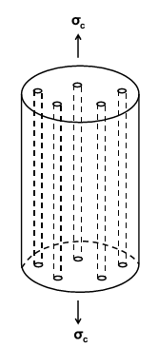
Hence
𝐅_{𝐜} = 𝐅_{𝐦} + 𝐅_{𝐟} --------- (1)
With
𝐅_{𝐜} = 𝛔_{𝐜}𝐀_{𝐜} ------------ (𝟐)
𝐅_{𝐦} = 𝛔_{𝐦}𝐀_{𝐦} -------- (𝟑)
𝐅_{𝐟} = 𝛔_{𝐟}𝐀_{𝐟} ------------- (𝟒)
Where A_{c}, A_{m} and A_{f} are the cross-sectional areas of the
composite, matrix and fiber (all the fibers together), respectively,
such that:
𝐀_{𝐜} = 𝐀_{𝐦} + 𝐀_{𝐟} ------ (𝟓)
σ_{c} , σ_{m} , σ_{f} are the stresses of the composite, matrix and fiber,
respectively.

Slide 14
Iso-Strain Elastic Modulus of Lamellar Composite
• Isostrain condition:
Equal strain
ε_{c} = ε_{f} = ε_{m}=ε
Total applied load
F_{c} = F_{f} + F_{m}
Stress
σ = F/A
σ_{c}A_{c} = σ_{f}A_{f} + σ_{m}A_{m}

Slide 15
From equation 1:
𝛔_{𝐜}𝐀_{𝐜} = 𝛔_{𝐦}𝐀_{𝐦} + 𝛔_{𝐟}𝐀_{𝐟} ------- (𝟔)
However,
𝝈_{𝒄} = 𝑬_{𝒄}𝜺_{𝒄} ----------------------(𝟕)
𝝈_{𝒎} = 𝑬_{𝒎}𝜺_{𝒎} --------------- (𝟖)
𝝈_{𝒇} = 𝑬_{𝒇}𝜺_{𝒇} ------------------ (𝟗)
Thus, Eq. 6 becomes
𝑬_{𝒄}𝜺_{𝒄}𝑨_{𝒄} = 𝑬_{𝒎}𝜺_{𝒎}𝑨_{𝒎} + 𝑬_{𝒇}𝜺_{𝒇}𝑨_{𝒇} ---------- (𝟏𝟎)
When a fiber-oriented composite is loaded in the longitudinal direction of fiber the alignment then the strain in the fiber, matrix, and composite are equal (iso-strain).
𝑬= elasticity of matrix
Due to the isostrain situation (𝜺_{𝒄} = 𝜺_{𝒎} = 𝜺_{𝒇}), the three strains are equal and can be canceled. Hence,

Slide 16
𝑬_{𝒄}𝑨_{𝒄} = 𝑬_{𝒎}𝑨_{𝒎} + 𝑬_{𝒇}𝑨_{𝒇} ----------- (𝟏𝟏)
Dividing by Ac gives
${EC}^{}=Em \left(\frac{Am}{Ac}\right)+Ef (\frac{Af}{Ac})$ ---------(12)
Where $\frac{Am}{Ac}$ and $\frac{Af}{Ac}$ are the area fractions of the matrix and fiber phases, respectively. If the composite, matrix, and fiber phase lengths are all equal, $\frac{Am}{Ac}$ is equivalent to the volume fraction of the matrix, (Vm) , and likewise for the fibers, Vf = $\frac{Af}{Ac}$ thus equation 12 becomes
E_{𝒄} = 𝑬_{𝒎}𝑽_{𝒎} + 𝑬_{𝒇} 𝑽_{𝒇} ----------------- (𝟏𝟑) (Rule of mixture of binary composites)
Or, 𝑬_{𝒄} = 𝑬_{𝒎} (𝟏 − 𝑽_{𝒇}) + 𝑬_{𝒇} 𝑽_{𝒇} ---- (𝟏𝟒)
Because the composite consists of only matrix and fiber phases;
that is, 𝑽_{𝒎} + 𝑽_{𝒇} = 𝟏.
It can also be shown, for longitudinal, that the ratio of the load carried by the fibers to that carried by the matrix is
$\frac{Ef}{Em}$= $\frac{EfVf}{Em Vm}$ ------------------------ (15)

Slide 17
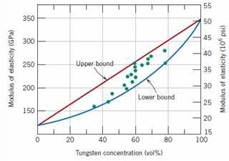
In particle reinforced composite the elastic modulus shall fall between upper and lower values as per volume fraction.
Rule of mixture: equation predict that the elastic modulus should fall between an upper and lower bound as shown:
• Example: Fig. plots upper and lower bound E_{c} – versus V_{p} curves for a copper–tungsten composite; in which tungsten is the particulate phase.
Upper Elastic Modulus of composite,
Lower Elastic Modulus of composite,

Slide 18
The longitudinal tensile strength of composite materials is determined mostly by the strength and volume content of the fiber reinforcement. The breaking strength of the fibers is much greater than the strength of the polymer matrix, and therefore the fibers determine the ultimate strength of the composite. The fiber strengths are typically 50 to 100 times higher than the matrix and, consequently, the strength of the matrix has little influence on the in-plane tensile strength of composite materials.

Slide 19
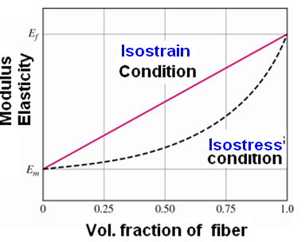
Higher modulus values are obtained with isostrain loading for equal volume of fibers

Slide 20
Example
A continuous and aligned glass fiber-reinforced composite consists of 40 vol% of glass fibers having a modulus of elasticity of 69 GPa and 60 vol% of a polyester resin that, when hardened, displays a modulus of 3.4 GPa.
(a) Compute the modulus of elasticity of this composite in the longitudinal direction.
(b) If the cross-sectional area is 250 mm² and a stress of 50 MPa is applied in this longitudinal direction, compute the magnitude of the load carried by each of the fiber and matrix phases.
(c) Determine the strain that is sustained by each phase when the stress in part (b) is applied.

Slide 21
Solution
(a) The modulus of elasticity of the composite is calculated using
equation (13): E_{𝒄} = 𝑬_{𝒎}𝑽_{𝒎} + 𝑬_{𝒇} 𝑽_{𝒇}
E_{c} = (3.4 GPa)(0.6) + (69 GPa)(0.4)
= 30 GPa
(b) To solve this portion of the problem, first find the ratio of fiber load to matrix load, using equation (15); thus,
$\frac{Ff}{Fm}$= $\frac{\left(69Gpa\right)(0.4)}{\left(3.4 Gpa\right)(0.6)}$
Or F_{f} = 13.5 F_{m}
In addition, the total force sustained by the composite Fc may be computed from the applied stress σ and total composite cross-sectional arae A_{c} according to:
F_{c} = A_{c} σ = (250 mm2)(50 MPa) = 12,500 N
However, this total load is just the sum of the loads carried by fiber and matrix phases; that is,
F_{c} = F_{f} + F_{m} = 12,500 N
Substitution for Ff from the preceding equation yields
13.5 Fm + Fm = 12,500 N Or Fm = 860 N
Whereas F_{f} = F_{c} – F_{m} = 12,500 N – 860 N = 11,640 N
Thus, the fiber phase supports the vast majority of the applied load.

Slide 22
(c) The stress for both fiber and matrix phases must first be calculated. Then, by using the elastic modulus for each [from part (a)], the strain values may be determined.
For stress calculation, phase cross-sectional areas are necessary:
Am = Vm Ac = (0.6)(250 mm²) = 150 mm²
and Af = Vf Ac = (0.4)(250 mm²) = 100 mm²
thus, 𝛔_{𝐦} = $\frac{Fm}{Am}$ = $\frac{860 N}{150 mm2}$ = 𝟓. 𝟕𝟑 𝐌𝐏𝐚
𝛔_{𝐟} = = $\frac{Ff}{Af}$= $\frac{11640 N}{100 mm2}$ = 𝟏𝟏𝟔. 𝟒 𝐌𝐏𝐚
Finally, strains are computed as:

Slide 23
_{𝒎}𝜺= $\frac{\text{σ}\text{m}}{\text{E}\text{m}}$= $\frac{5.73 MPa }{3.4x103 MPa}$ = 𝟏. 𝟔𝟗 ∗ 𝟏𝟎^{−𝟑}
𝜺_{𝒇} = $\frac{\text{σ}\text{f}}{\text{E}\text{f}}$= $\frac{116.4 MPa }{69x103 MPa}$ = 𝟏. 𝟔𝟗 ∗ 𝟏𝟎^{−𝟑}
Therefore, strains for both matrix and fiber phases are identical according to isostrain assumption.

